Slide 1
FLASHCARENTAL@GMAIL.COM
CONTACTO 5611285775

Slide 2
CANCÚN

Slide 3
REQUISITOS
REQUIREMENTS
*PASSPORT OR ID RETENTION
*1 SOCIAL NETWORK FAC/INSTAGRAM
*1 PHONE NUMBER OF A FRIEND OR FAMILY
*VALID DRIVER’S LICENSE
*PROOF OF ACCOMMODATION
*GUARANTEE DEPOSIT
*THE PRICE DOES NOT INCLUDE DELIVERY COST
*$40 USD CANCÚN
*$60 USD P.D.C
*$80 USD TULUM
RETENCIÓN DE PASAPORTE O INE
1 RED SOCIAL FACEBOOK/INSTAGRAM
1 NÚM. DE WHATSAPP AMIGO/FAMILIAR
COMPROBANTE DE ESTADÍA
LICENCIA DE CONDUCIR VIGENTE
DEPOSITO EN GARANTÍA
EL PRECIO NO INCLUYE COSTO DE ENTREGA
$40 USD CANCÚN
$60 USD P.D.C
$80 USD TULUM

Slide 4


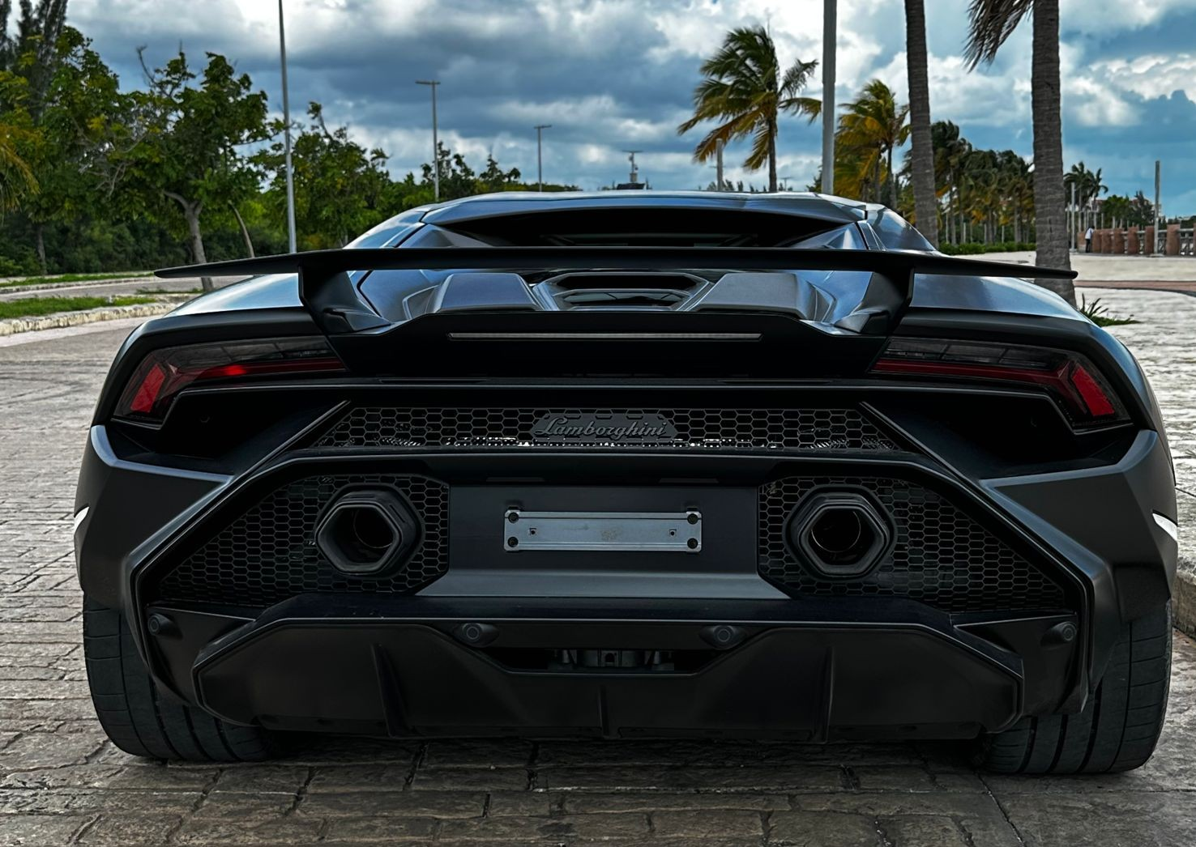
PRICE PER DAY
LAMBORGHINI HURACAN TECNICA 2023 (2 PAX)
WARRANTY
$10,000 USD
CREDIT CARD OR CASH
$5,000 USD

Slide 5
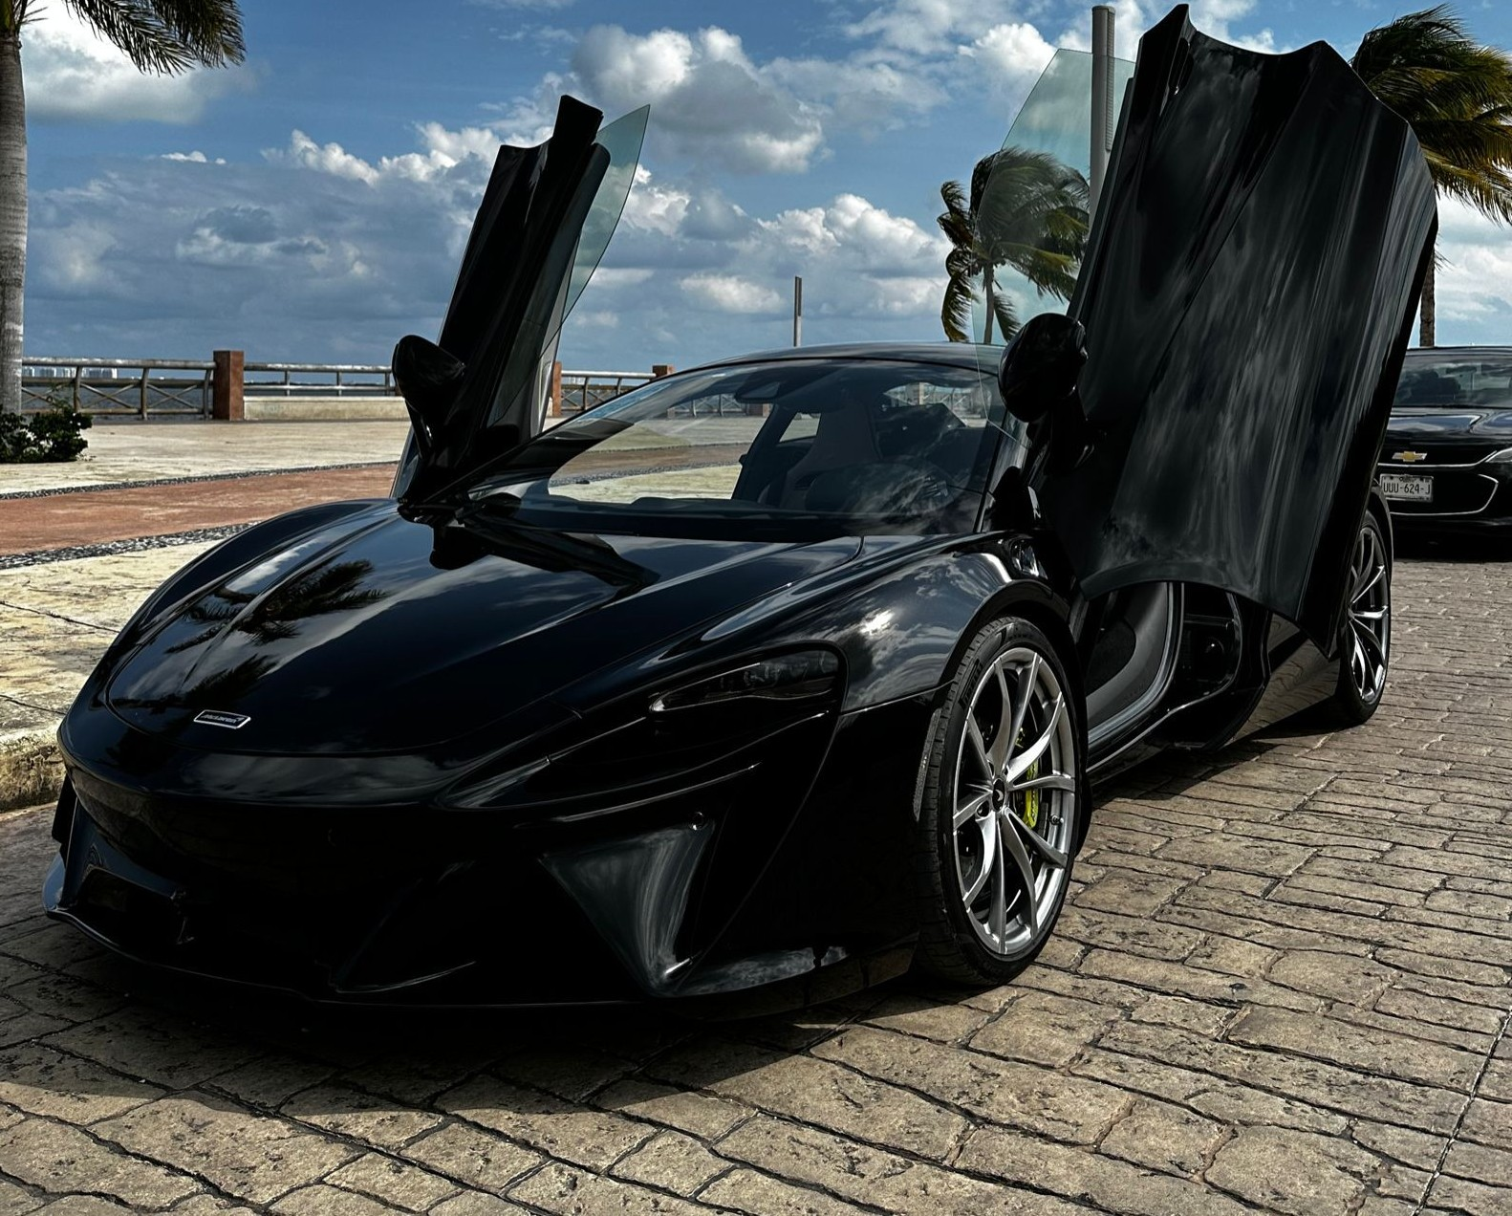
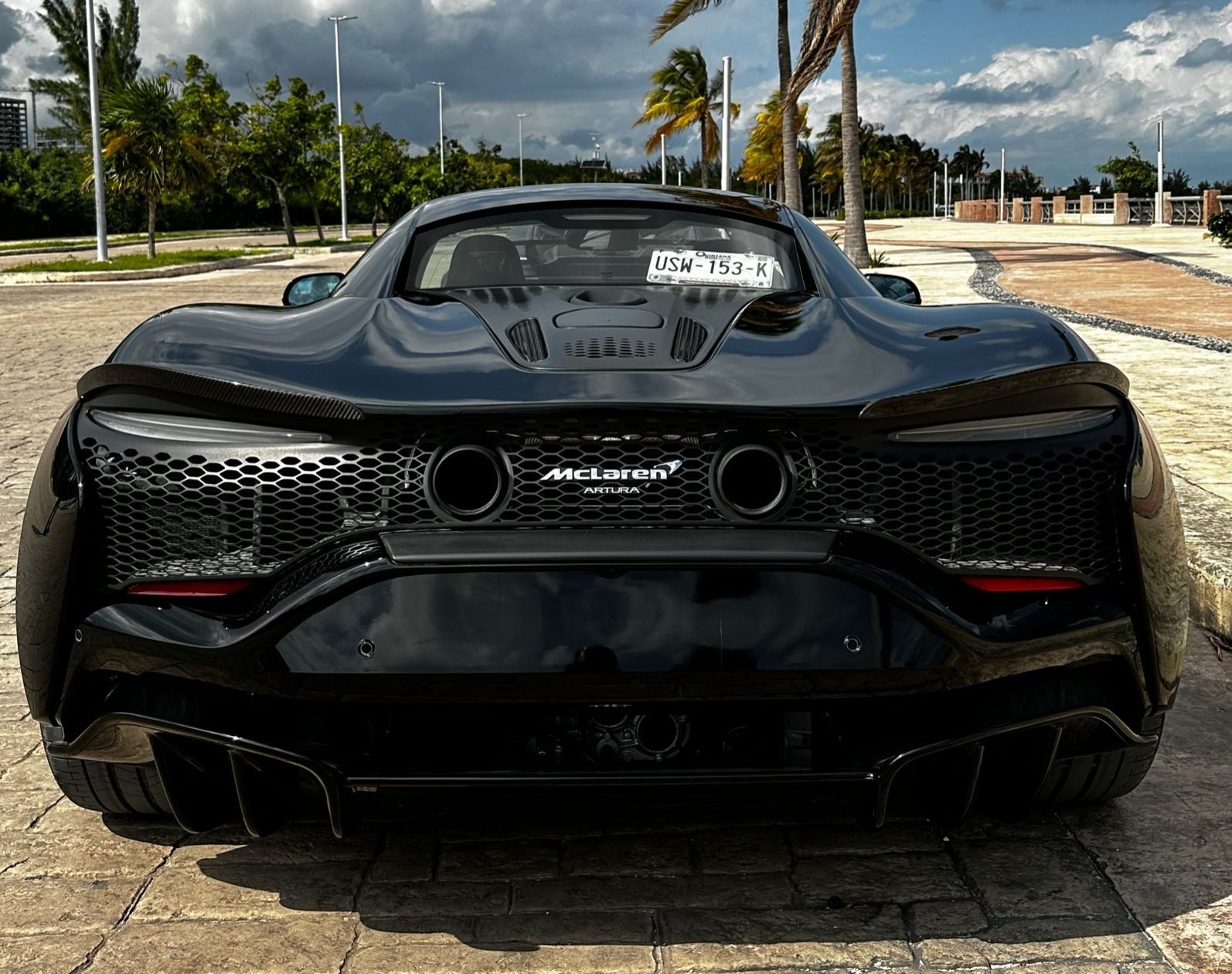
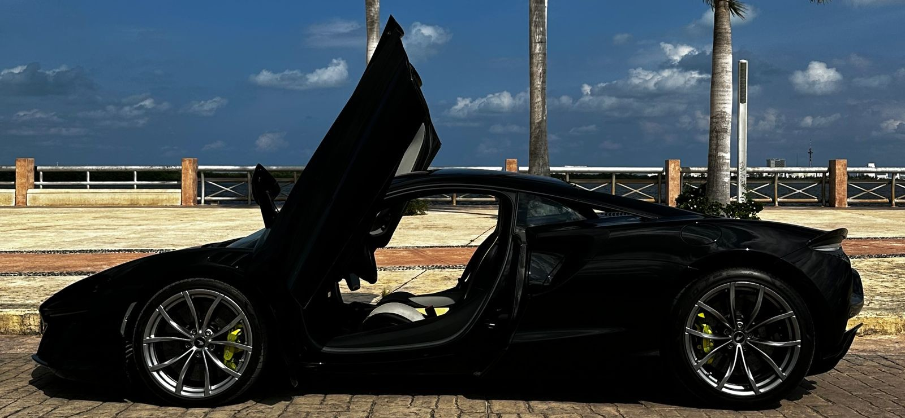
MCLAREN ARTURA COUPE 2023
PRICE PER DAY
$5,000 USD
WARRANTY
$10,000 USD
CREDIT CARD OR CASH

Slide 6

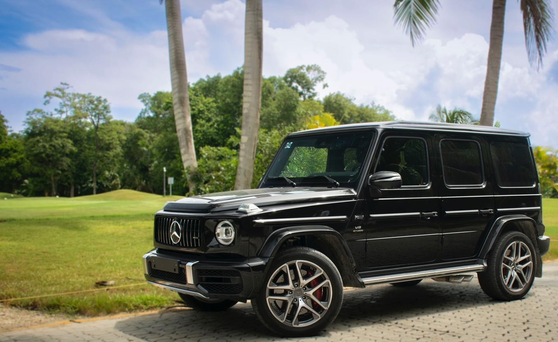
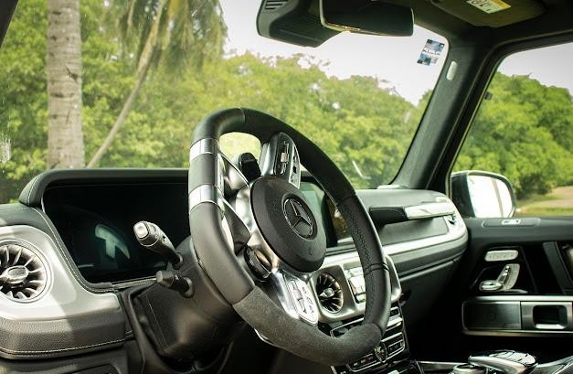
MERCEDES BENZ AMG G63 V8 2023
PRICE PER DAY
$2,300 USD
WARRANTY
$10,000 USD
CREDIT CARD OR CASH

Slide 7
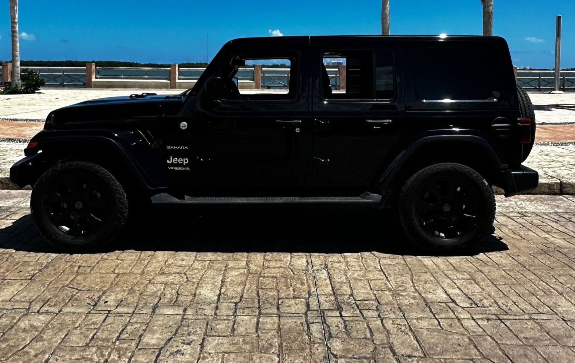
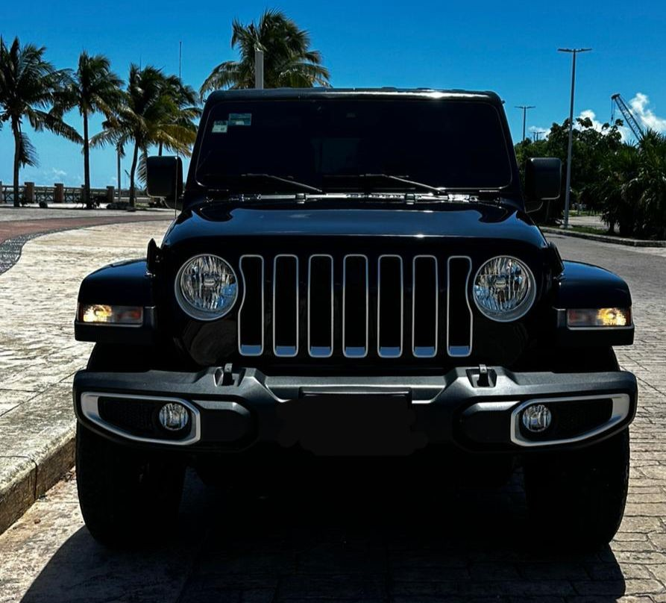
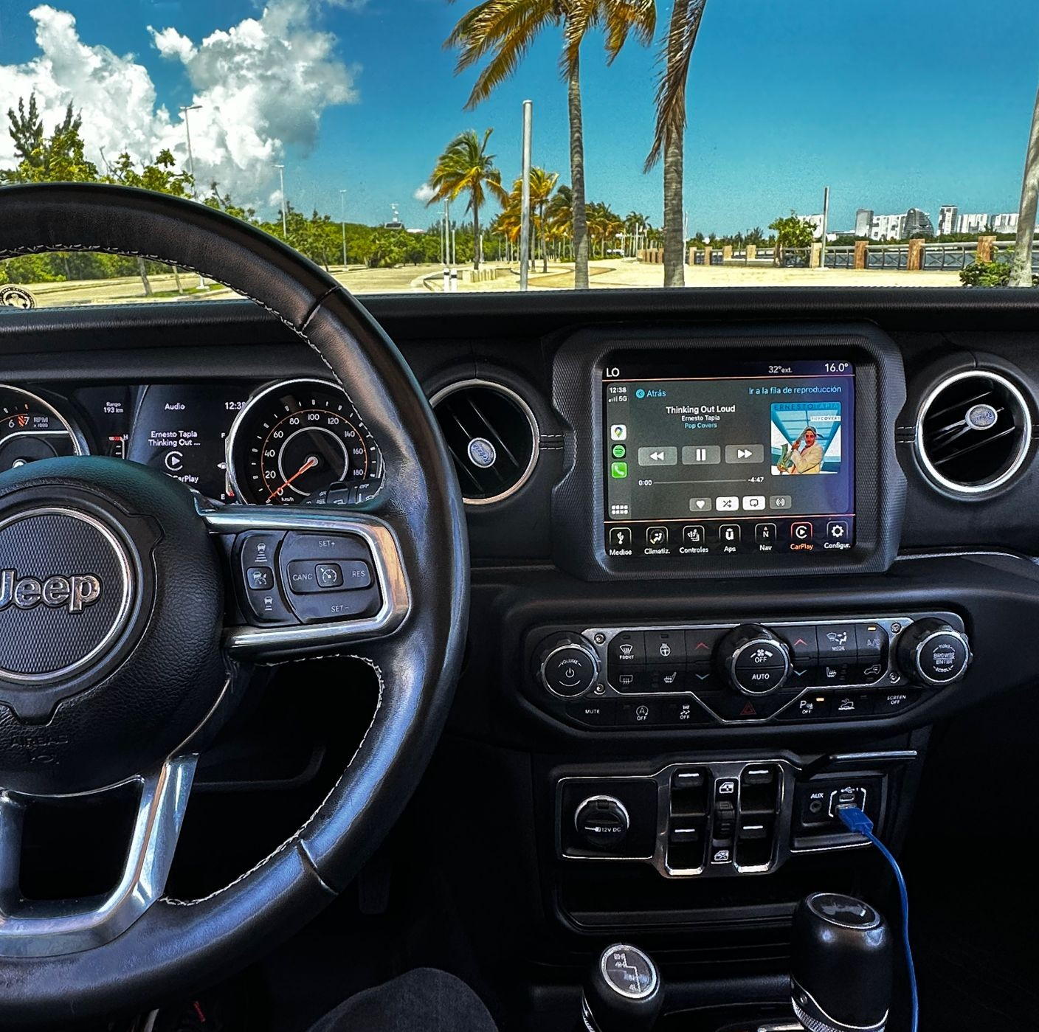
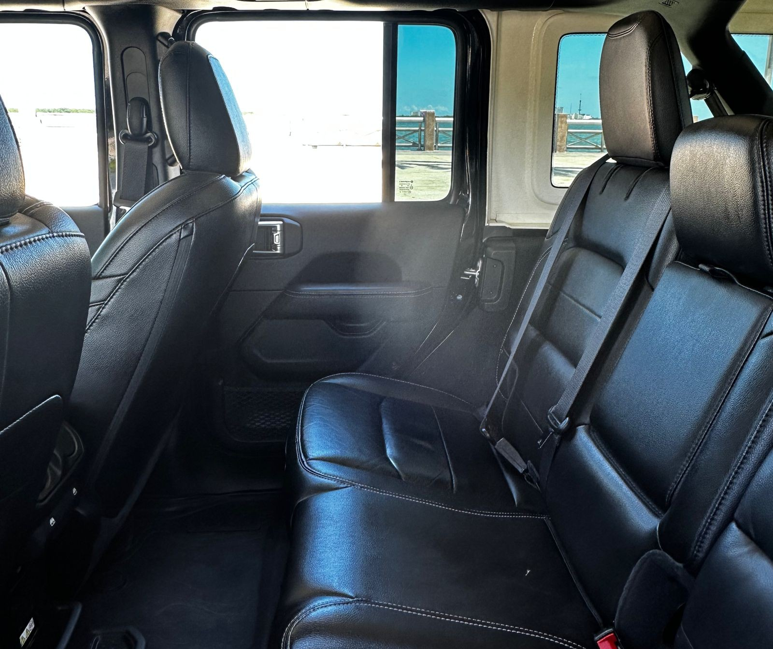
JEEP WRANGLER SAHARA (5 PAX)
PRICE PER DAY
$550 USD
WARRANTY
$3,500 USD
CREDIT CARD OR CASH

Slide 8
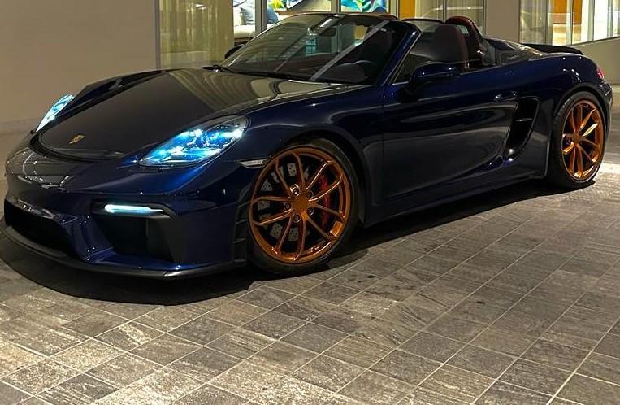



PORSCHE 718 SPYDER (2 PAX)
PRICE PER DAY
$1,550 USD
WARRANTY
$6,000 USD
CREDIT CARD OR CASH
@luxurycarsq.r

Slide 9
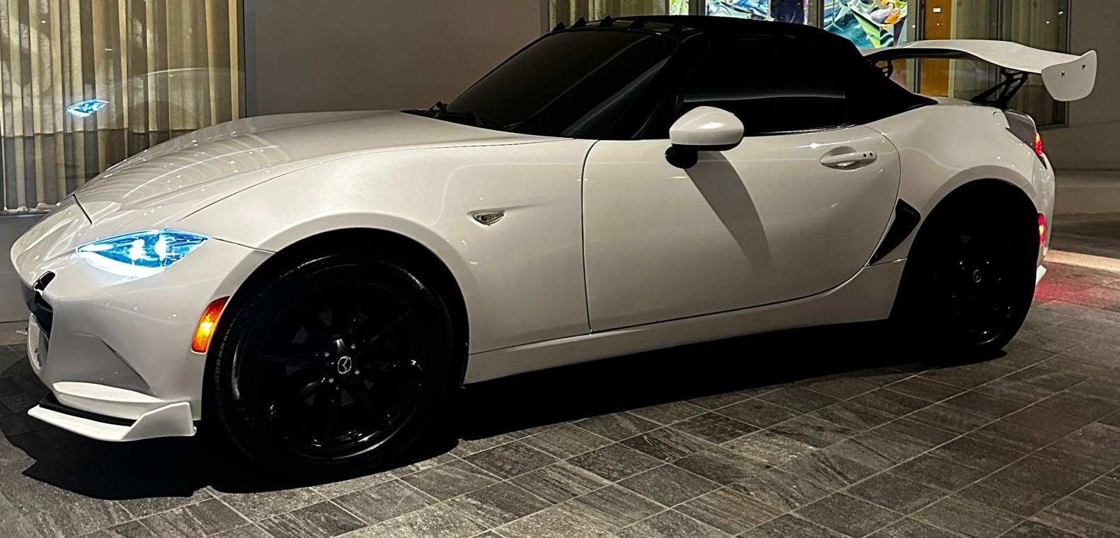
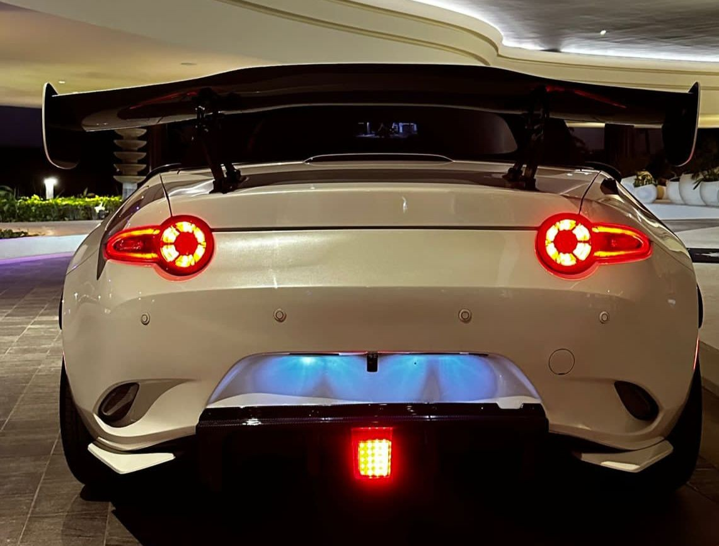
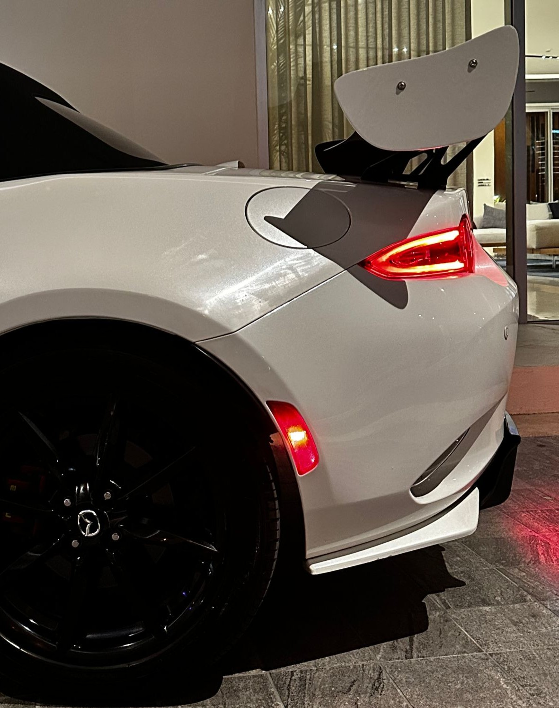
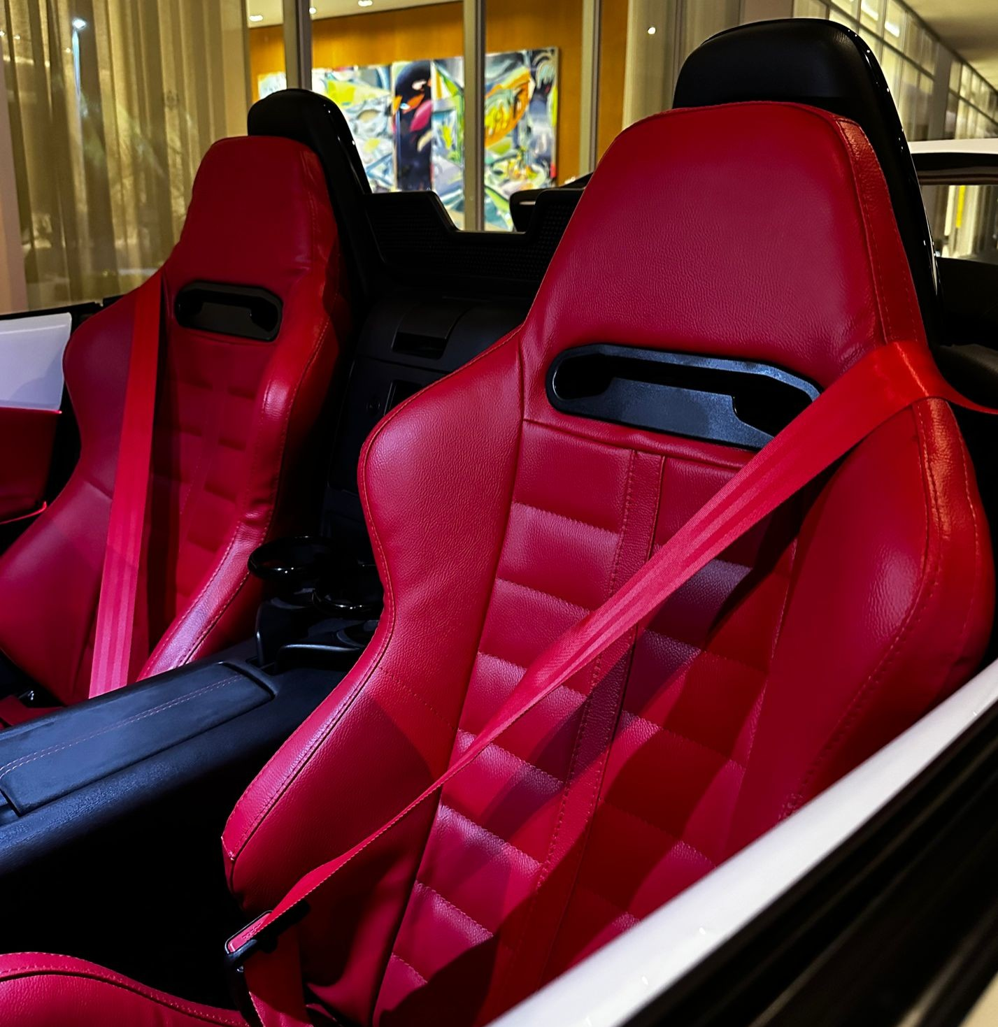
MAZDA MX-5 (2 PAX ) GRAND TURISMO
PRICE PER DAY
$400 USD
WARRANTY
$2,500 USD
CREDIT CARD OR CASH

Slide 10


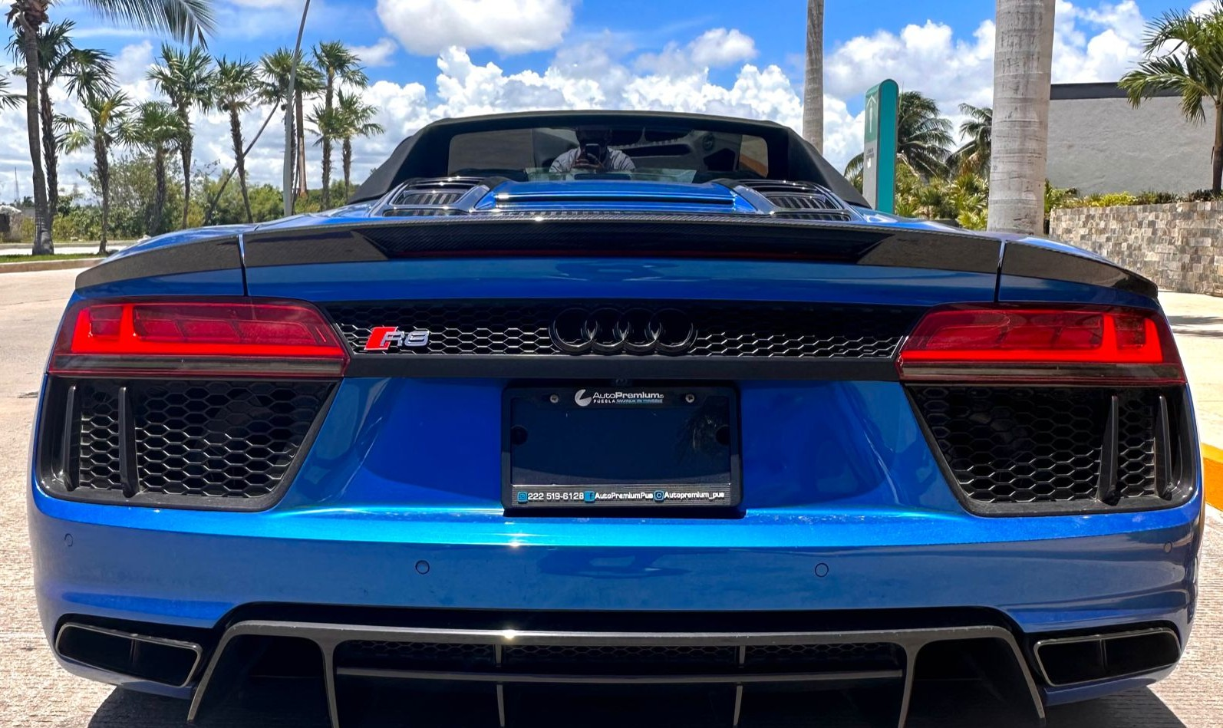
AUDI R8 SPYDER V10 (2 PAX)
WARRANTY
$6,000 USD
CREDIT CARD OR CASH
PRICE PER DAY
$2,300 USD

Slide 11
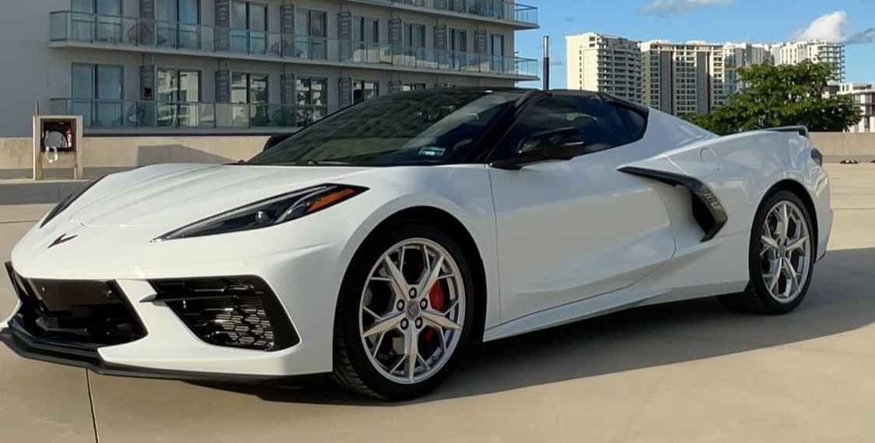

CORVETTE STINGRAY ( 2PAX )
PRICE PER DAY
$1,550 USD
WARRANTY
$6,000 USD
CREDIT CARD OR CASH

Slide 12
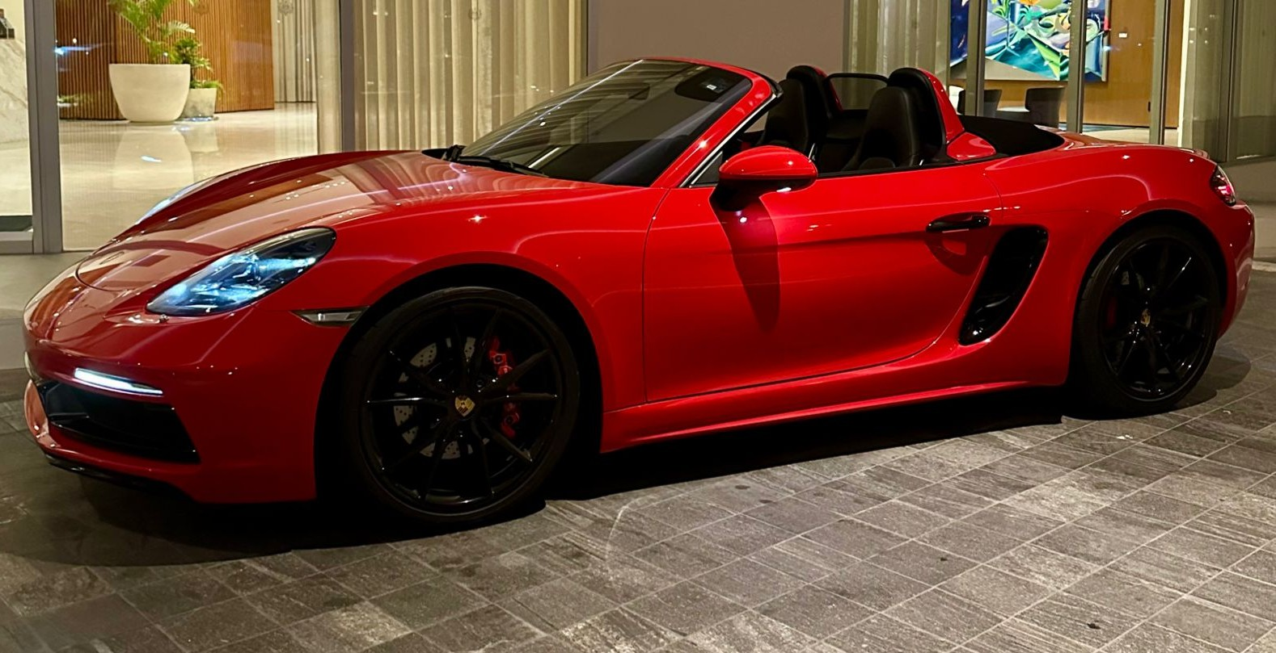
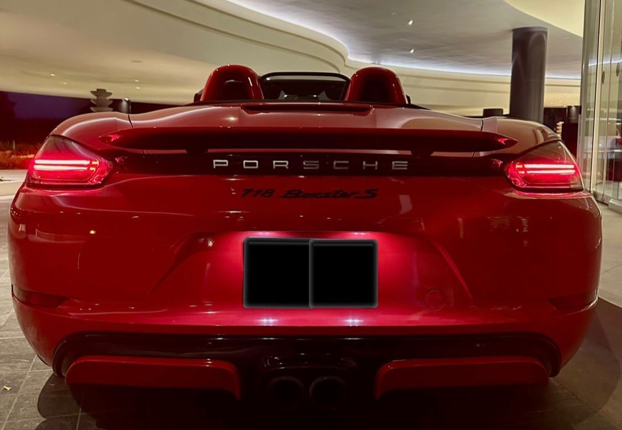
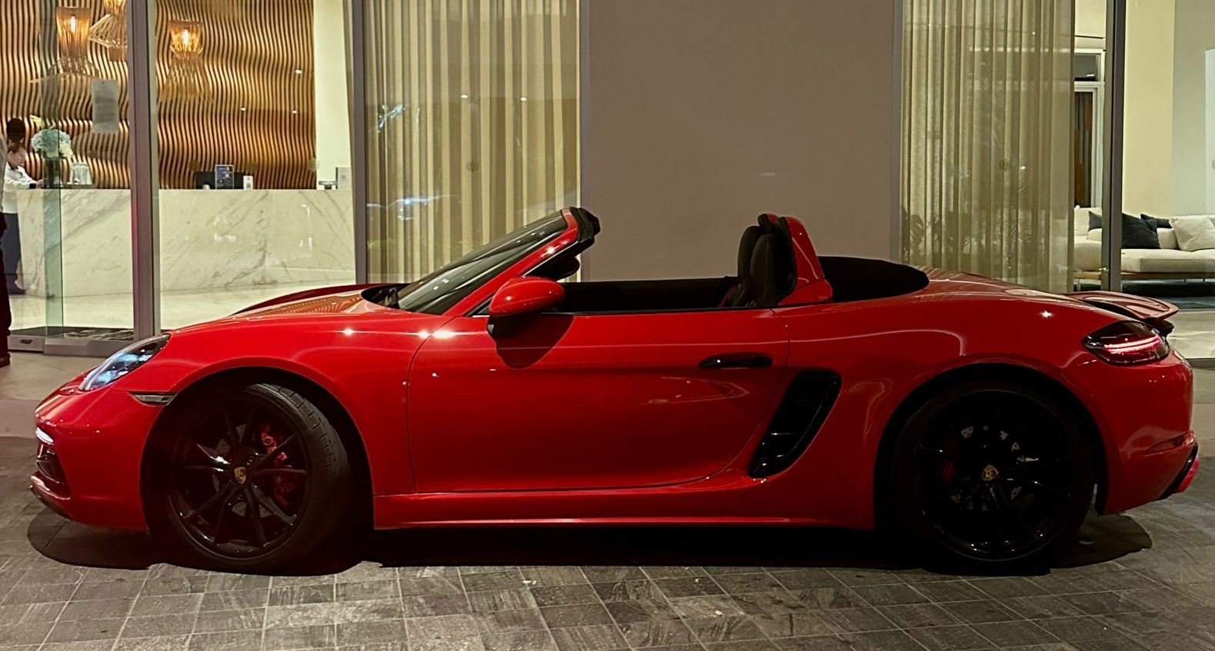
PORSCHE BOXTER S TURBO (2 PAX)
PRICE PER DAY
$1,450 USD
WARRANTY
$6,000 USD
CREDIT CARD OR CASH
@luxurycarsq.r

Slide 13
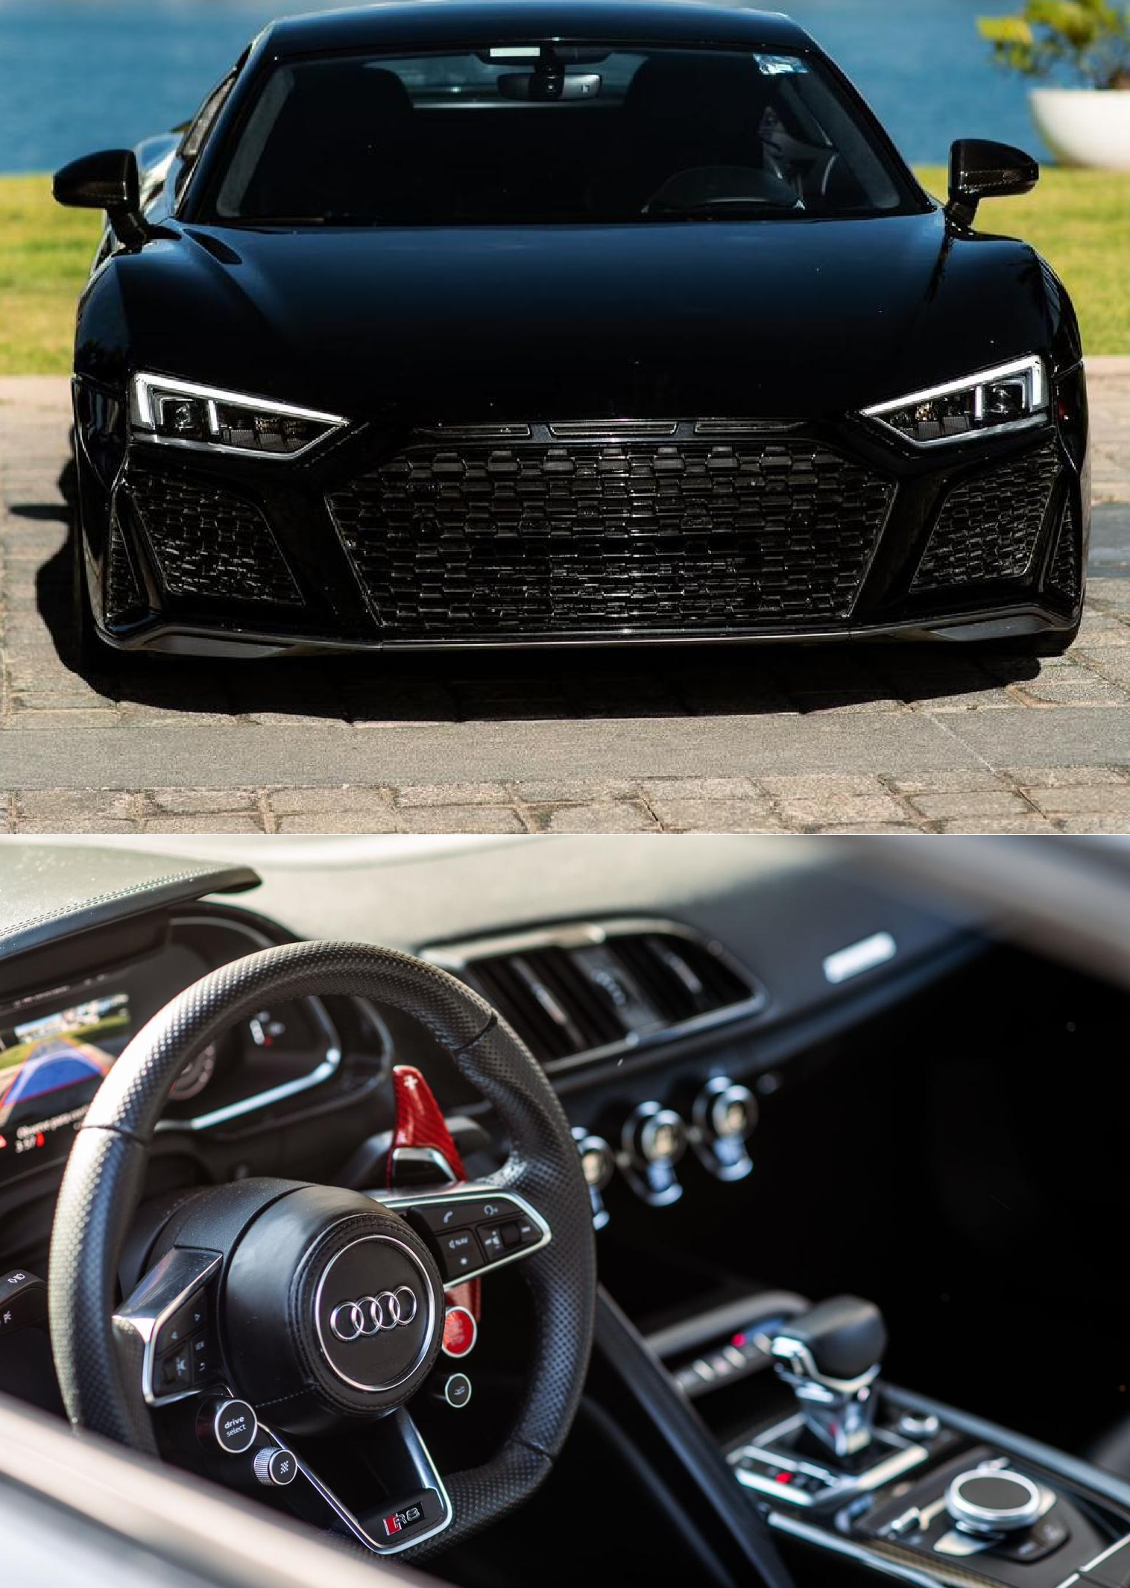
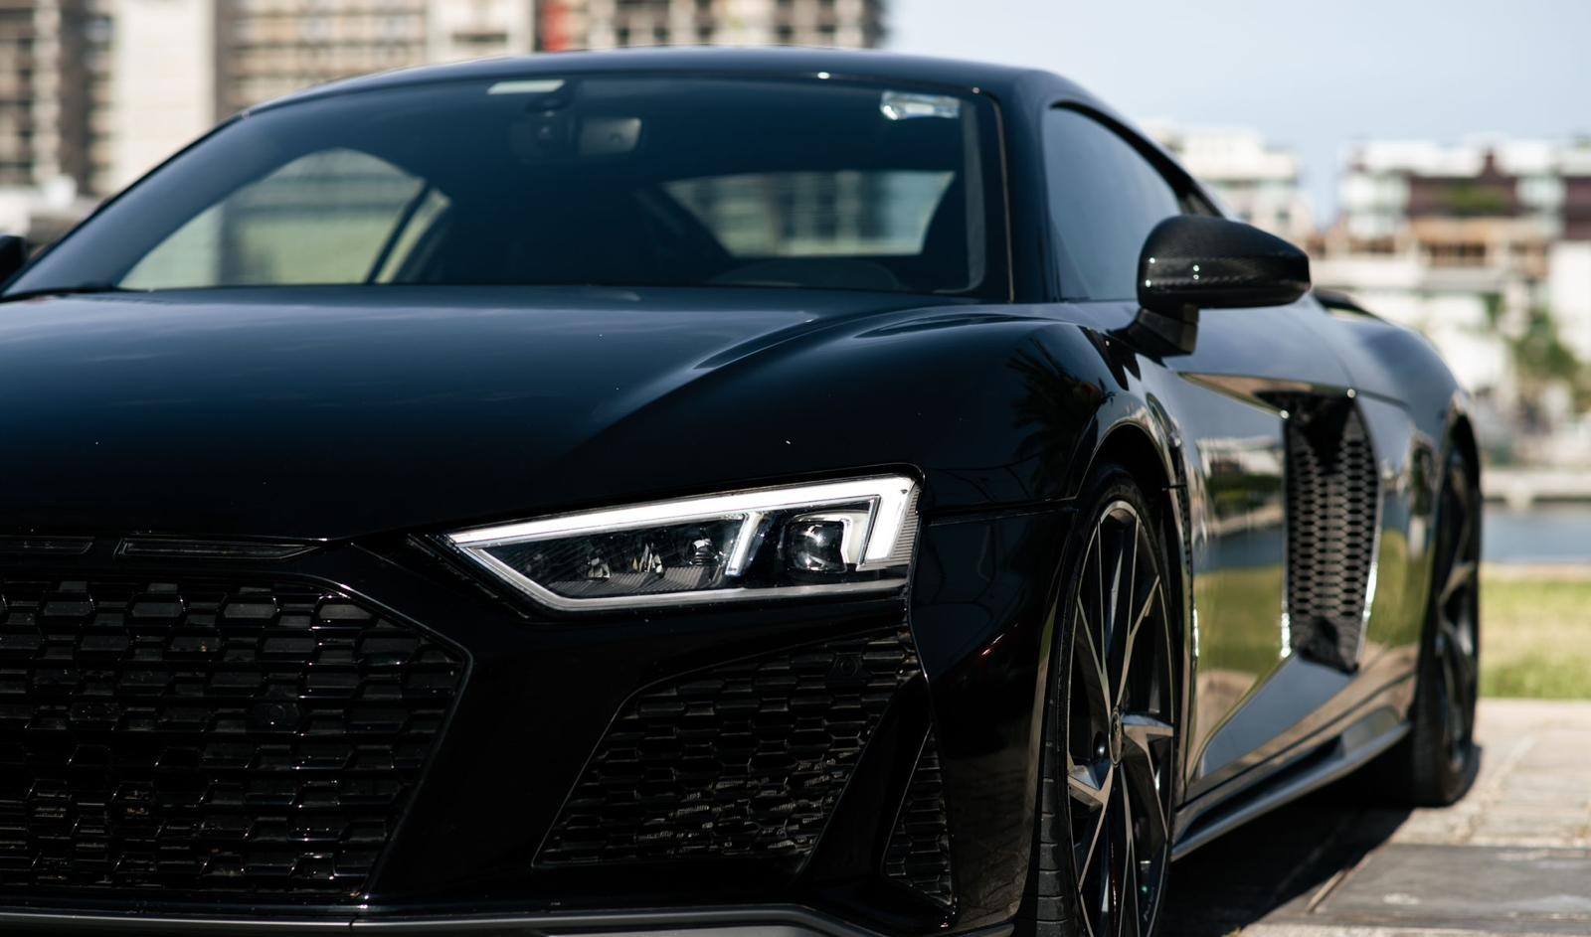
AUDI R8 V10 PLUS (2 PAX)
PRICE PER DAY
$1,950 USD
WARRANTY
$6,000 USD
CREDIT CARD OR CASH

Slide 14
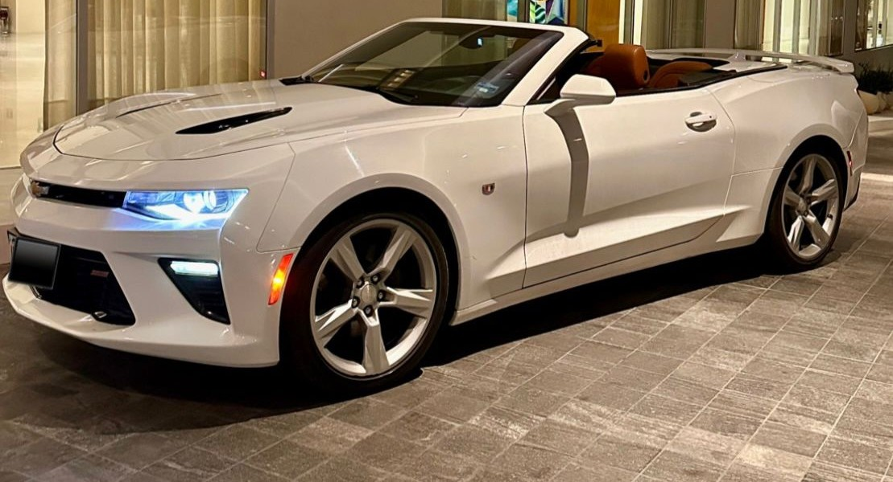
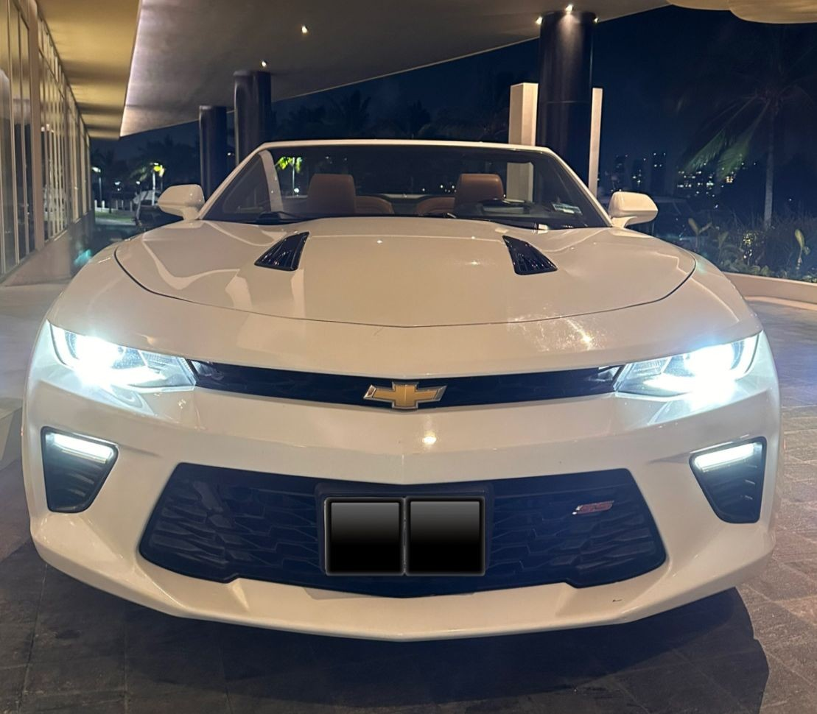
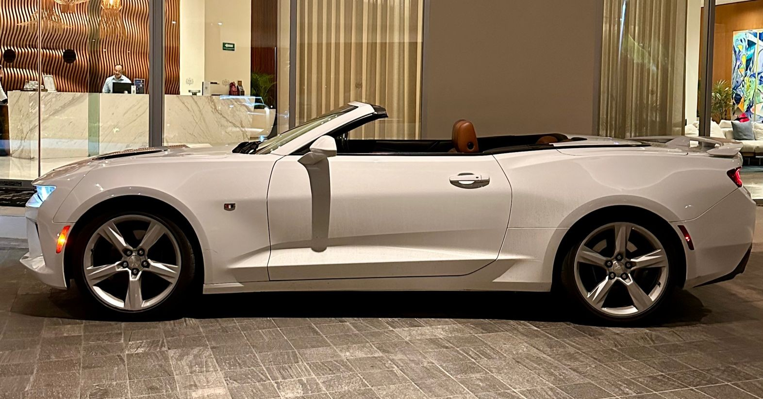
CHEVROLET CAMARO SS (4 PAX)
PRICE PER DAY
$500 USD
WARRANTY
$2,500 USD
CREDIT CARD OR CASH

Slide 15
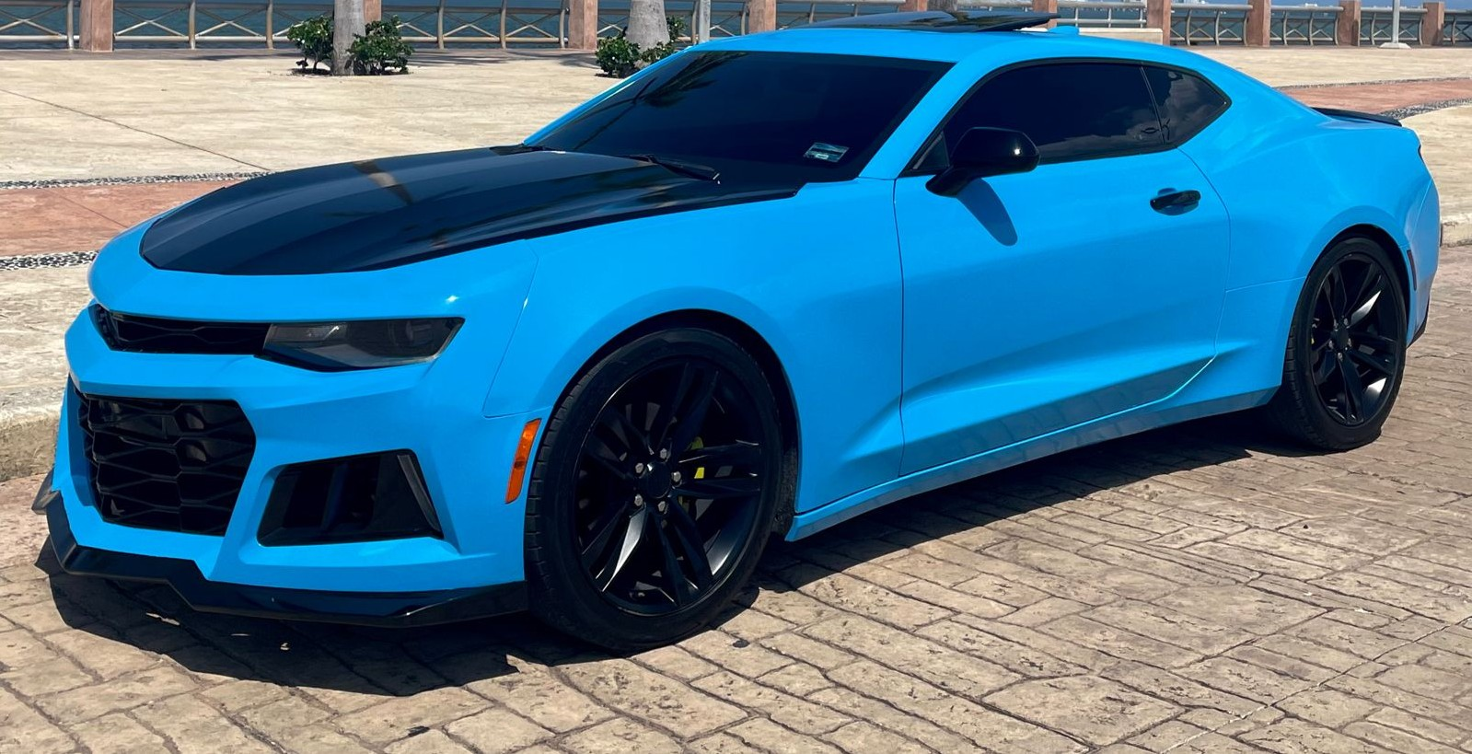
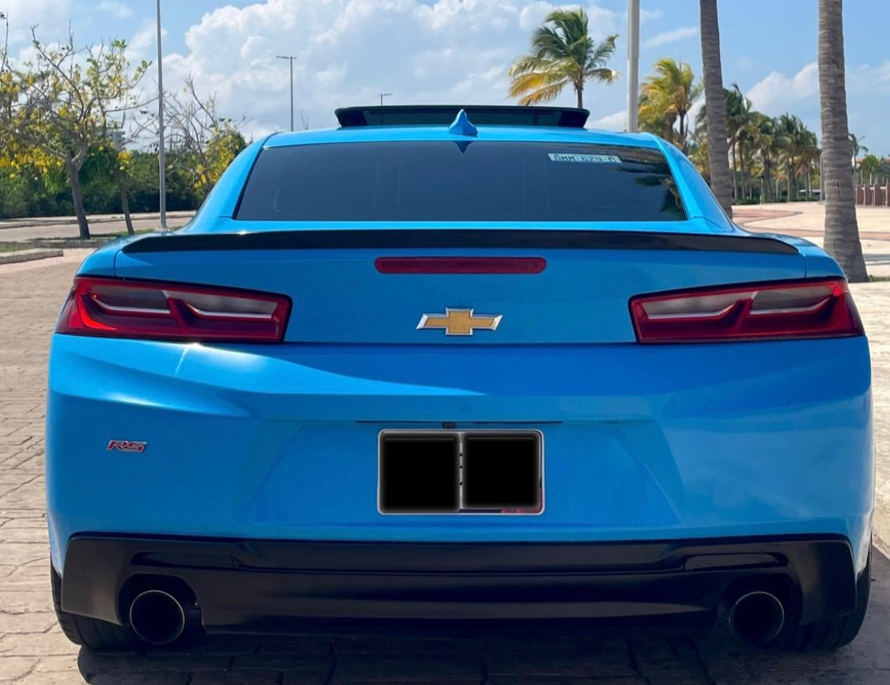
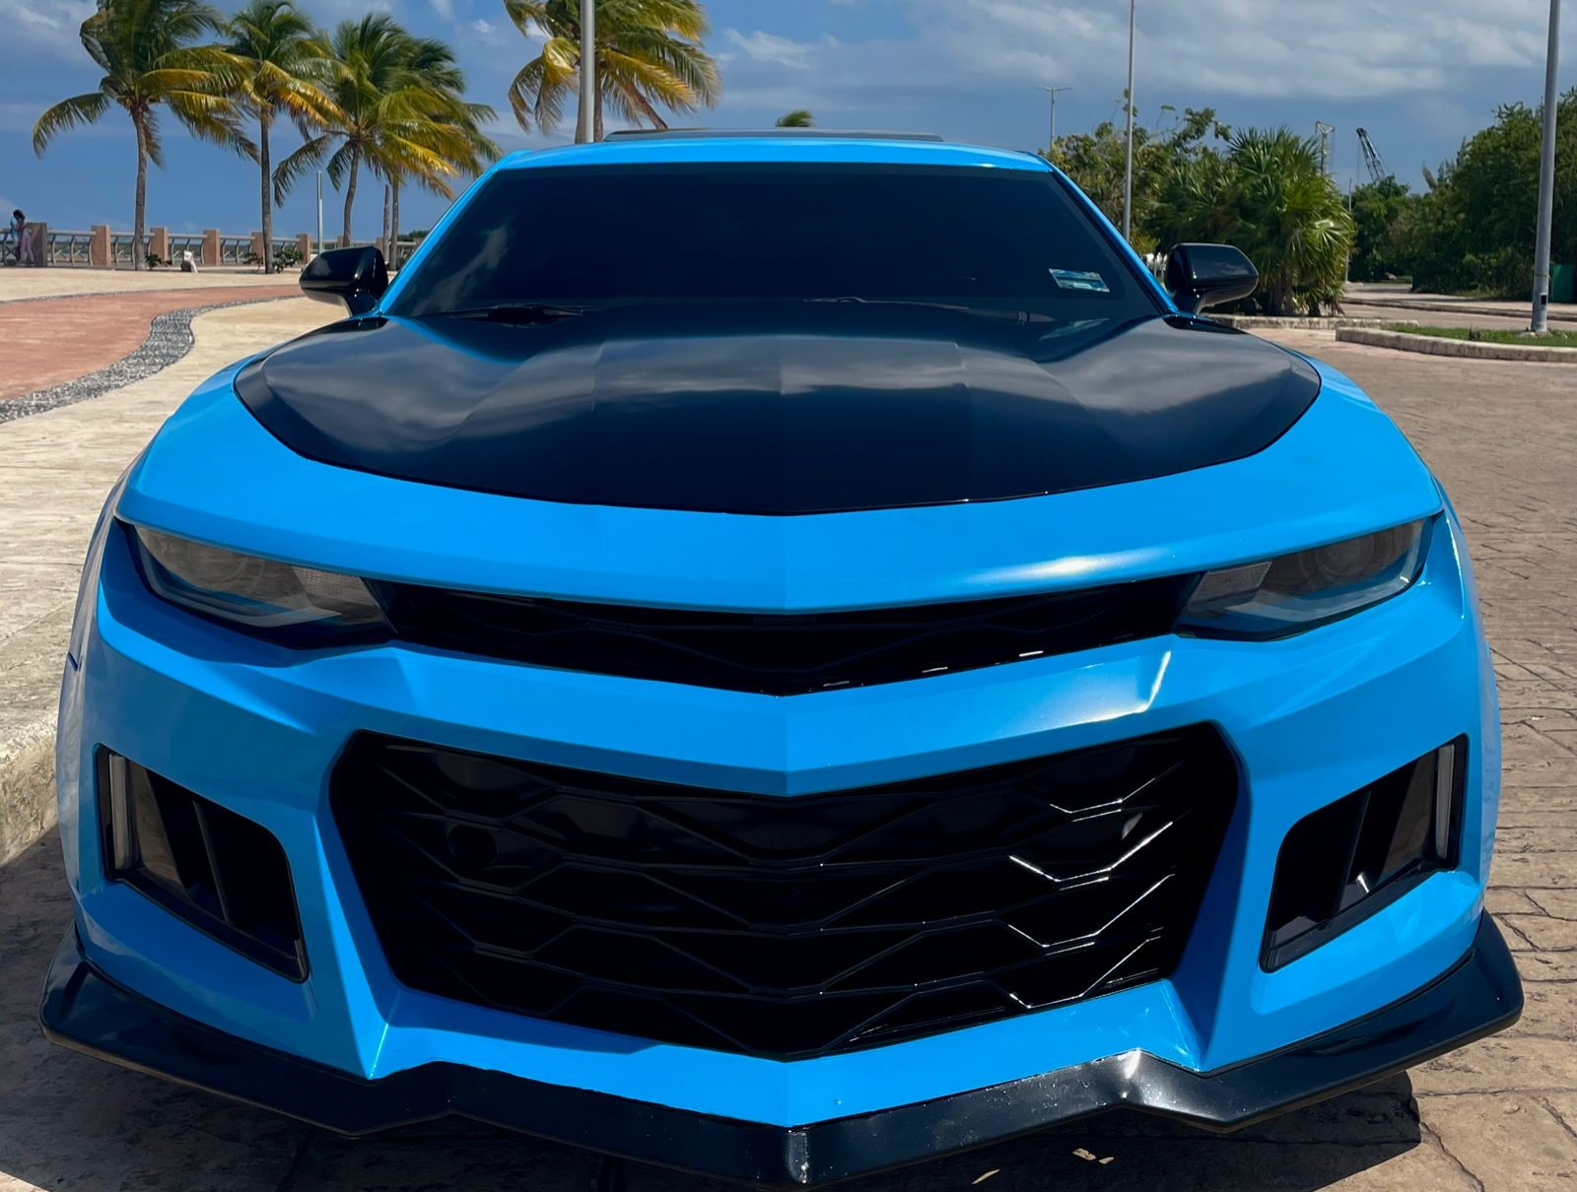
PRICE PER DAY
CHEVROLET CAMARO RS, ZL1 BODY KIT (4 PAX)
WARRANTY
$2,500 USD
CREDIT CARD OR CASH
$450 USD

Slide 16
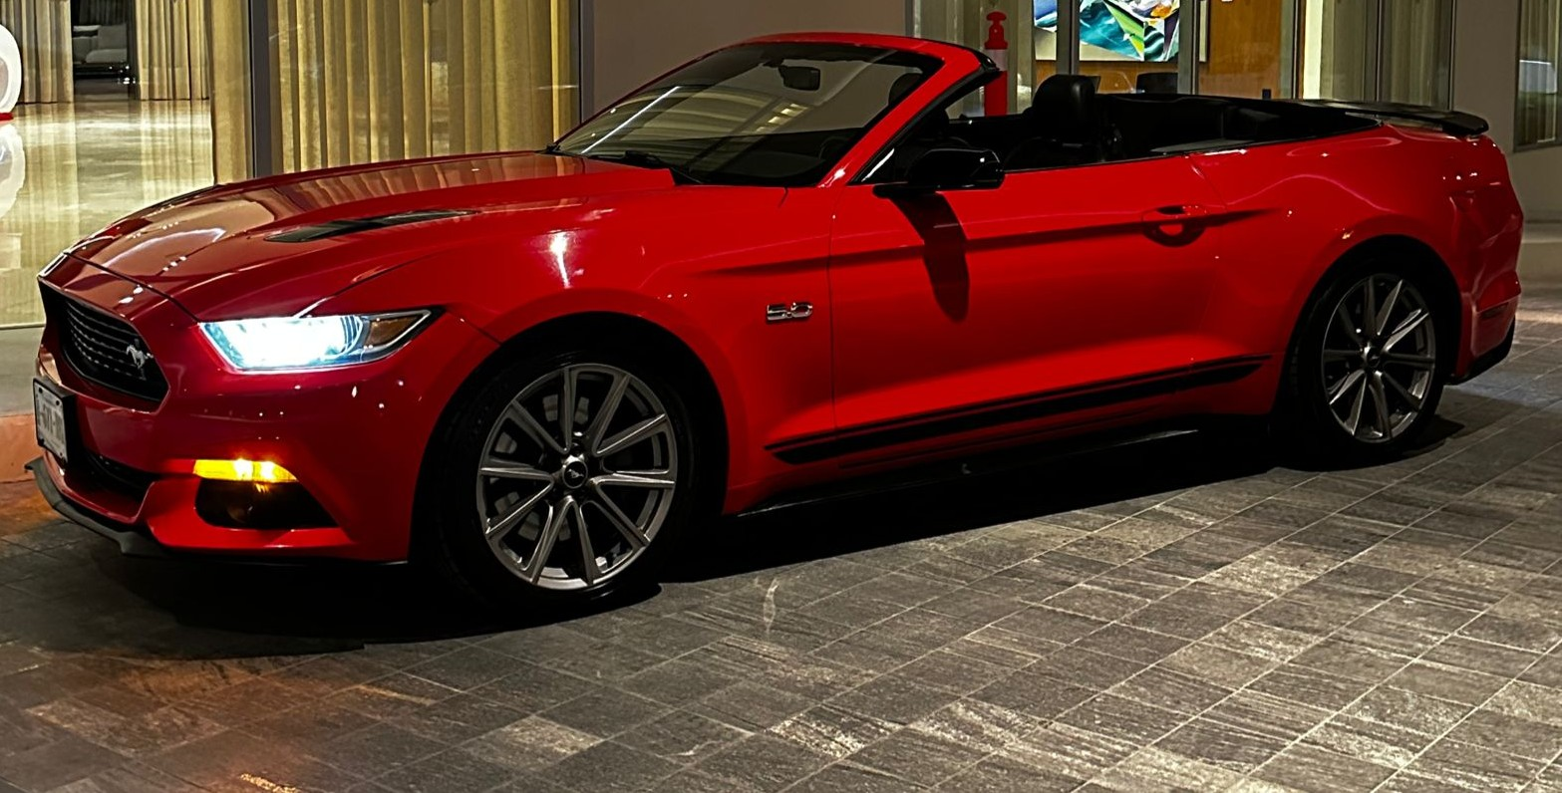
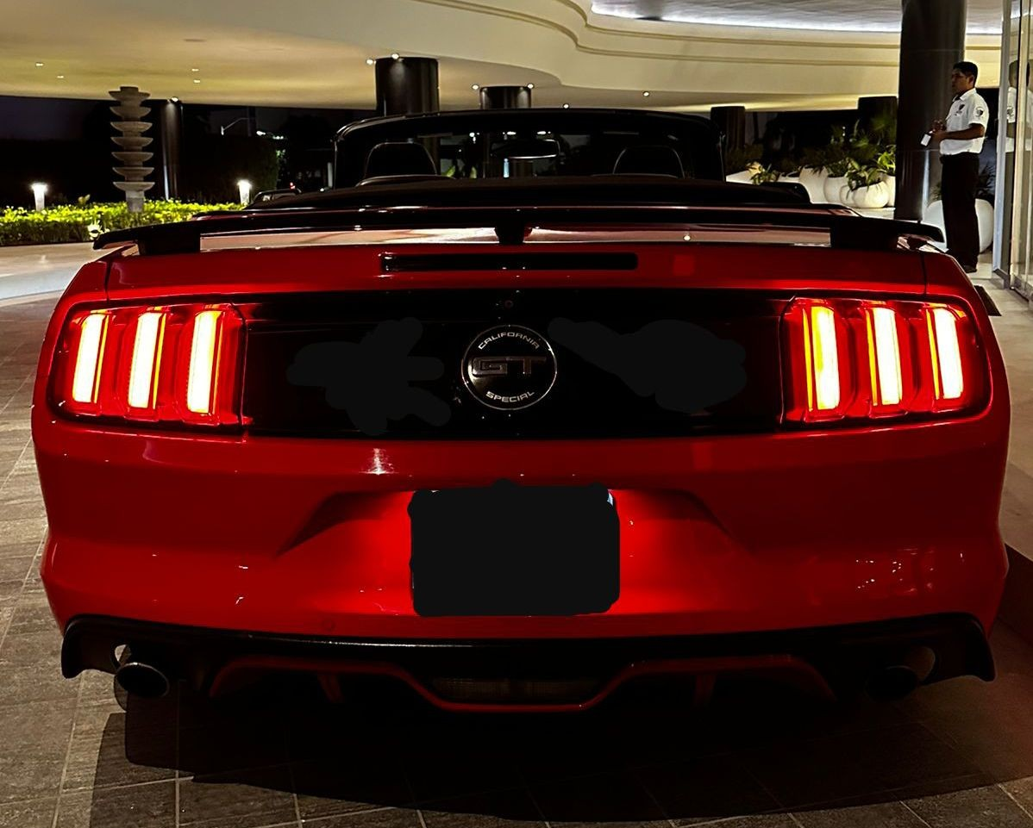
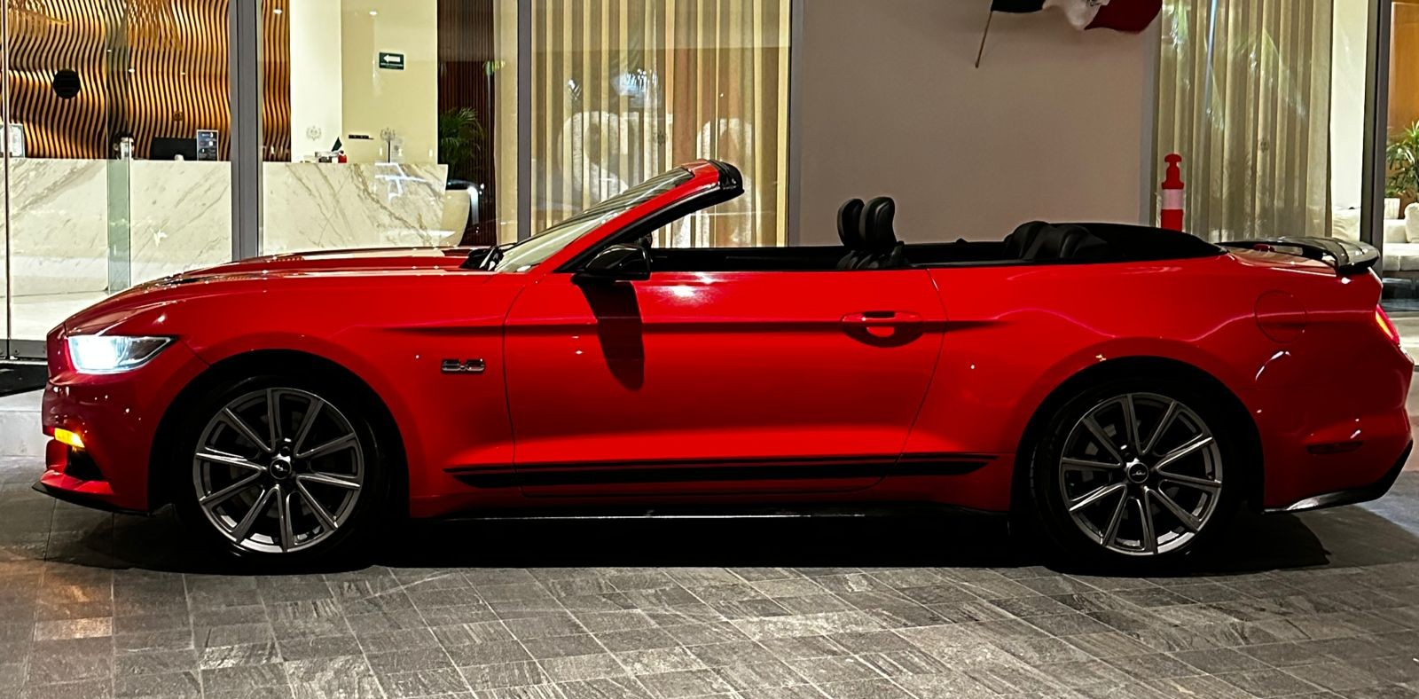
PRICE PER DAY
MUSTANG GT CALIFORNIA (4 PAX)
WARRANTY
$2,500 USD
CREDIT CARD OR CASH
$500 USD

Slide 17
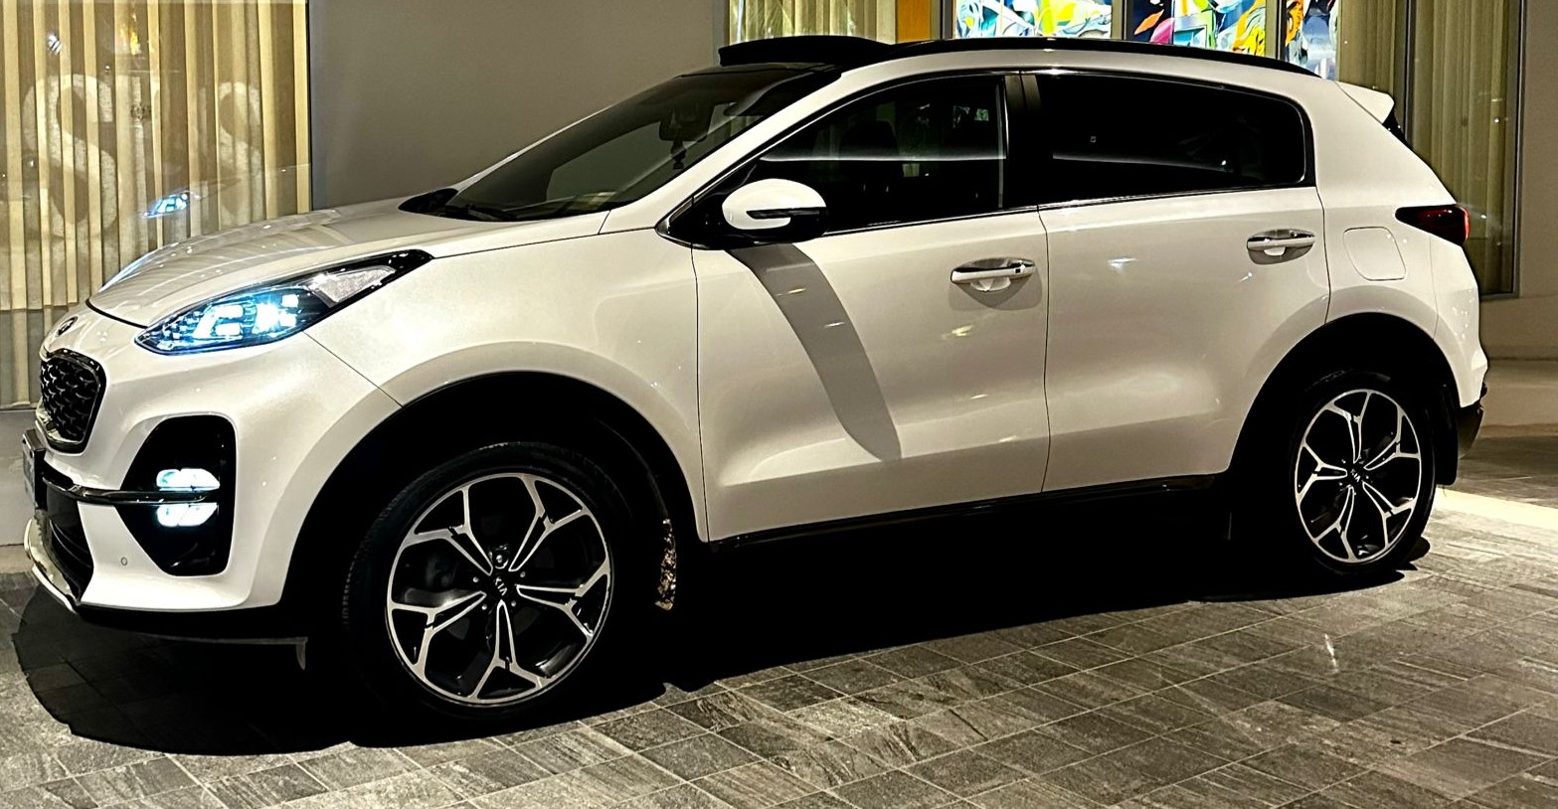
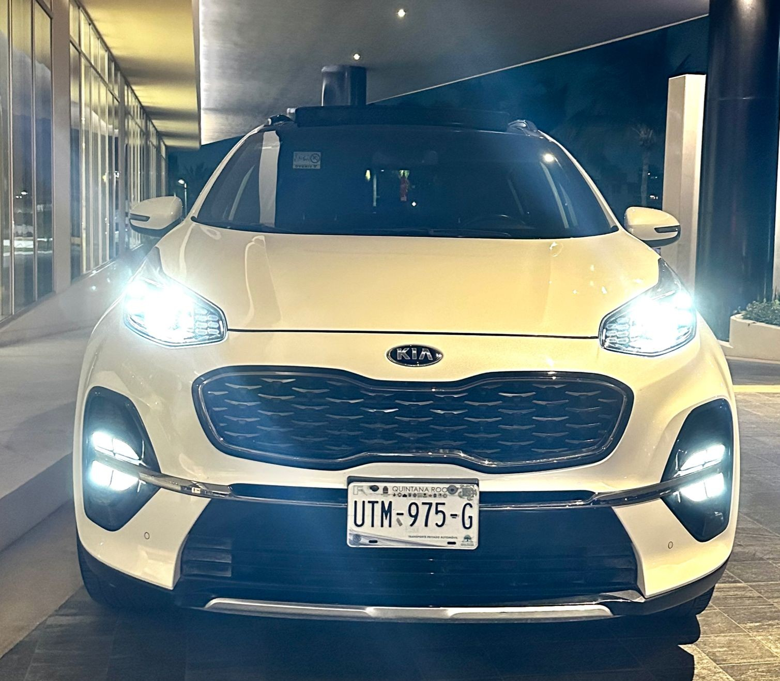
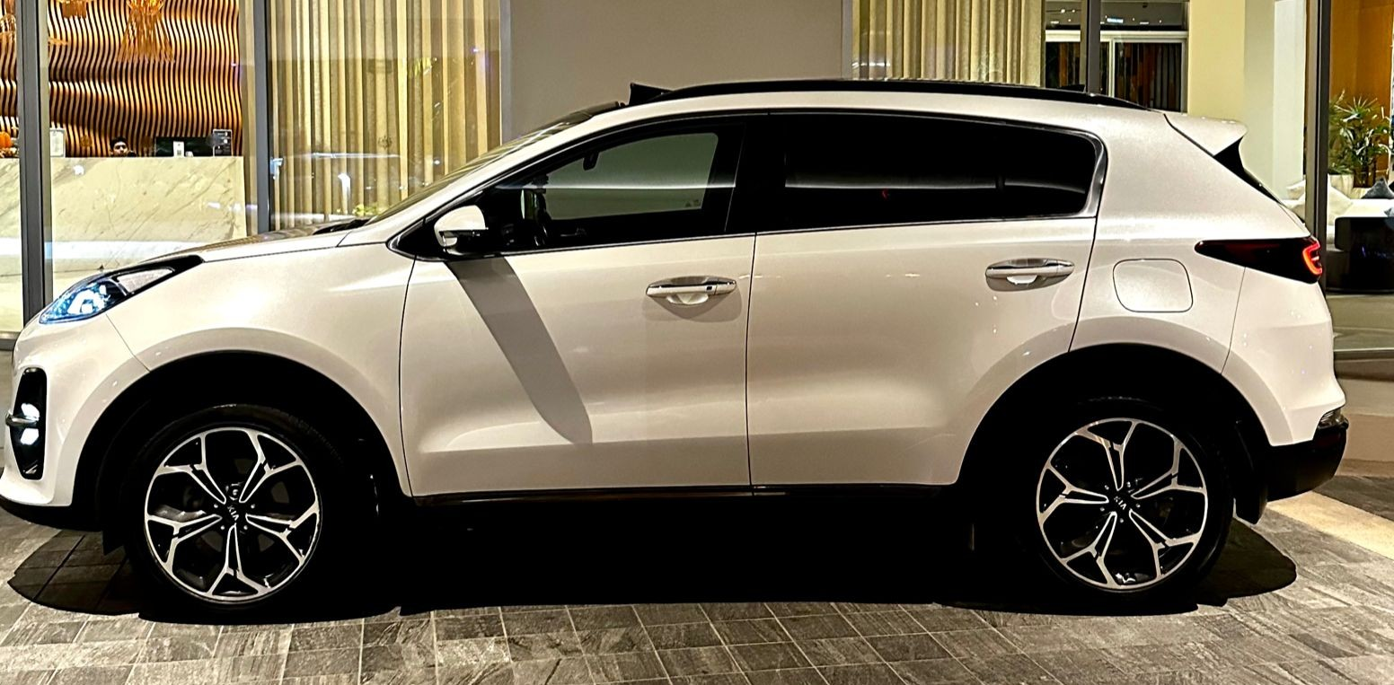
KIA SPORTAGE (5 PAX)
PRICE PER DAY
$250 USD
WARRANTY
$1,200 USD
CREDIT CARD OR CASH

Slide 18
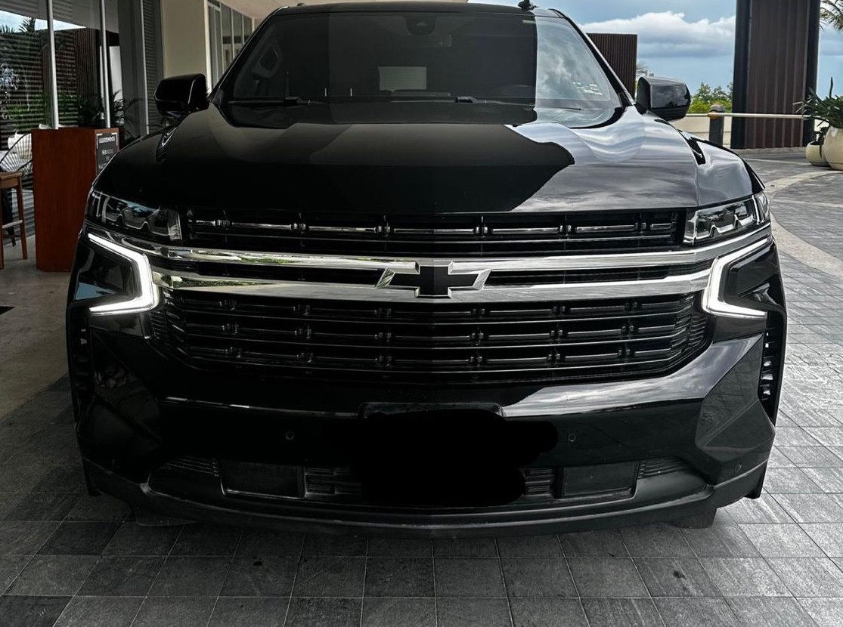
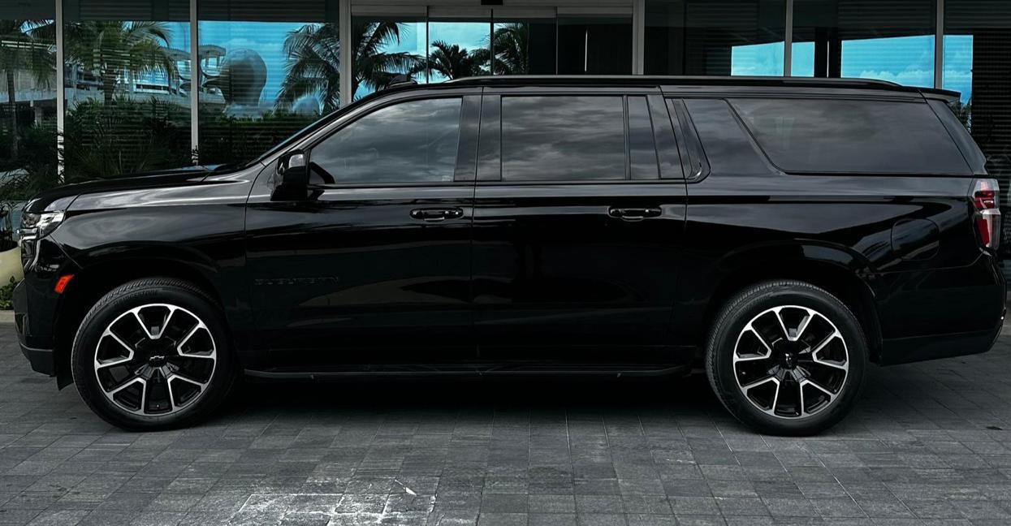
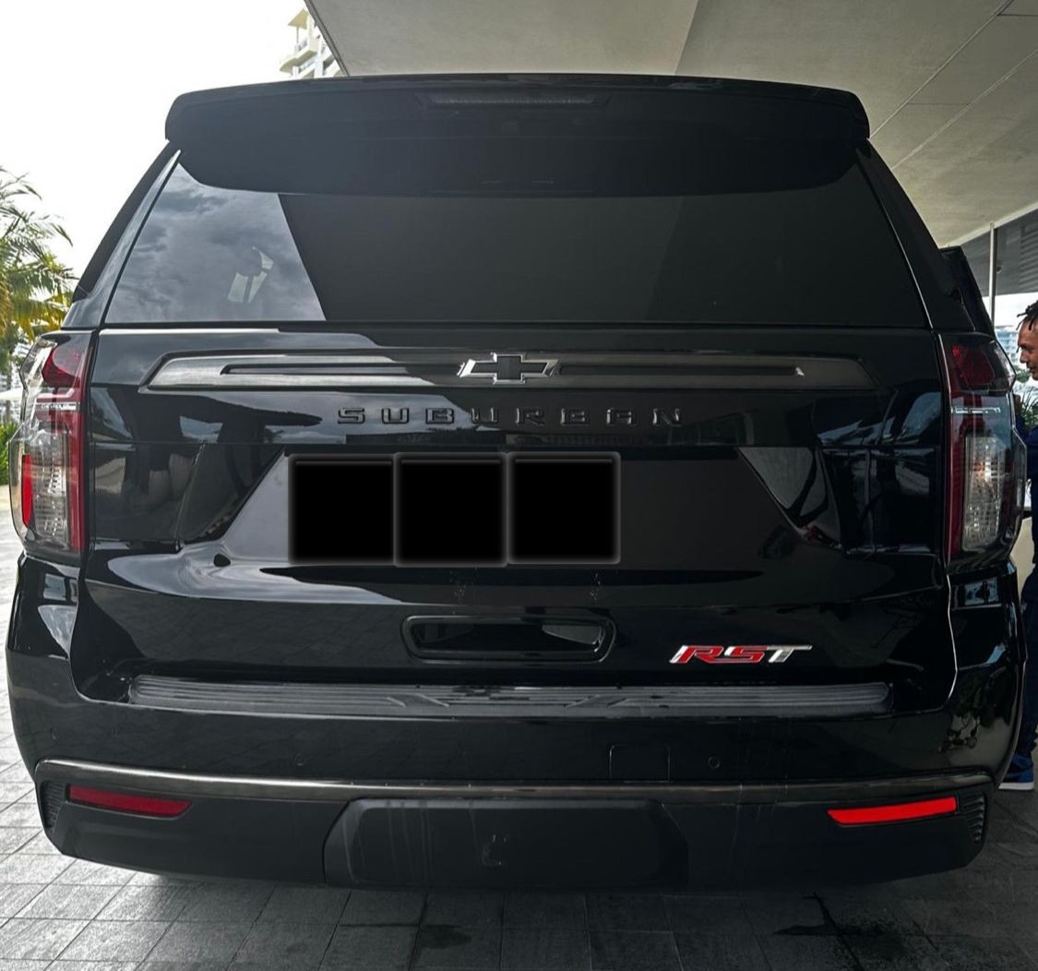
PRICE PER DAY
SUBURBAN RST (8 PAX)
WARRANTY
$4,000 USD
CREDIT CARD OR CASH
$700 USD

Slide 19
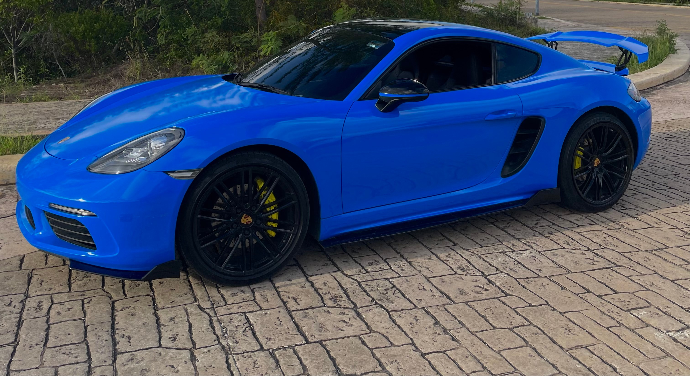
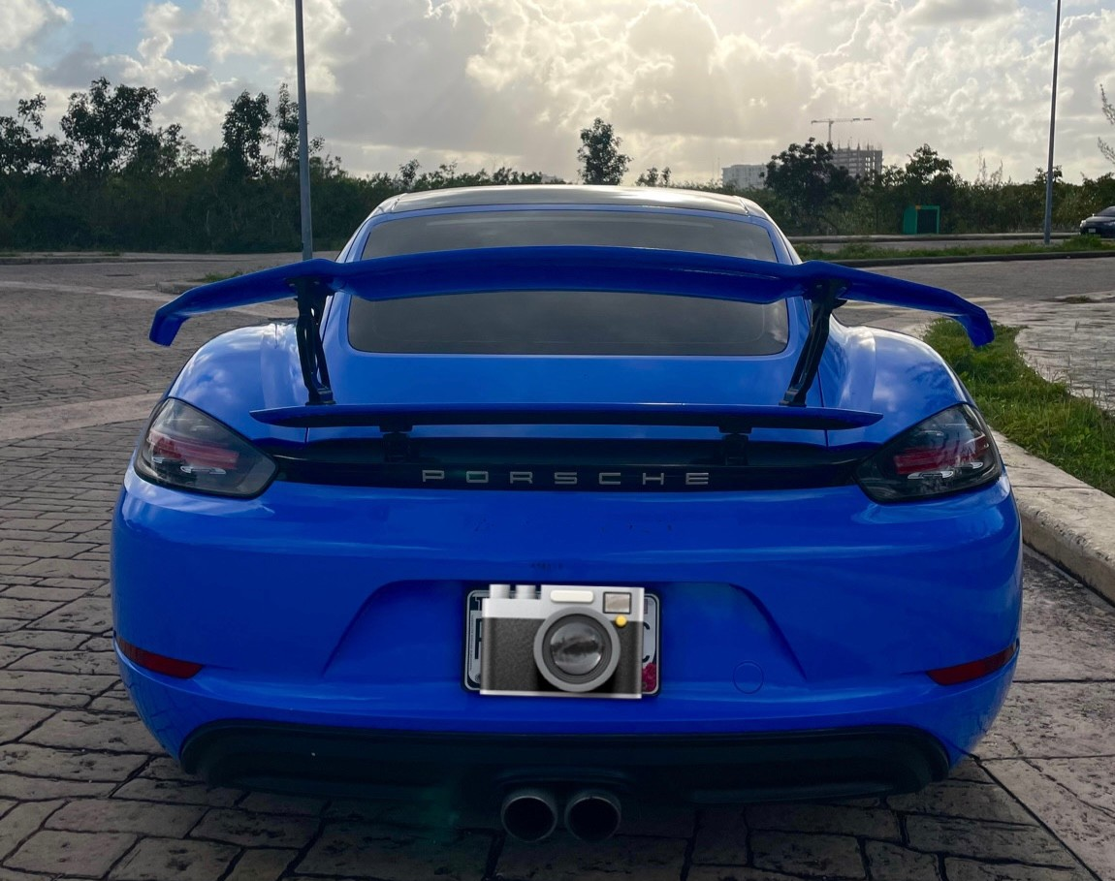
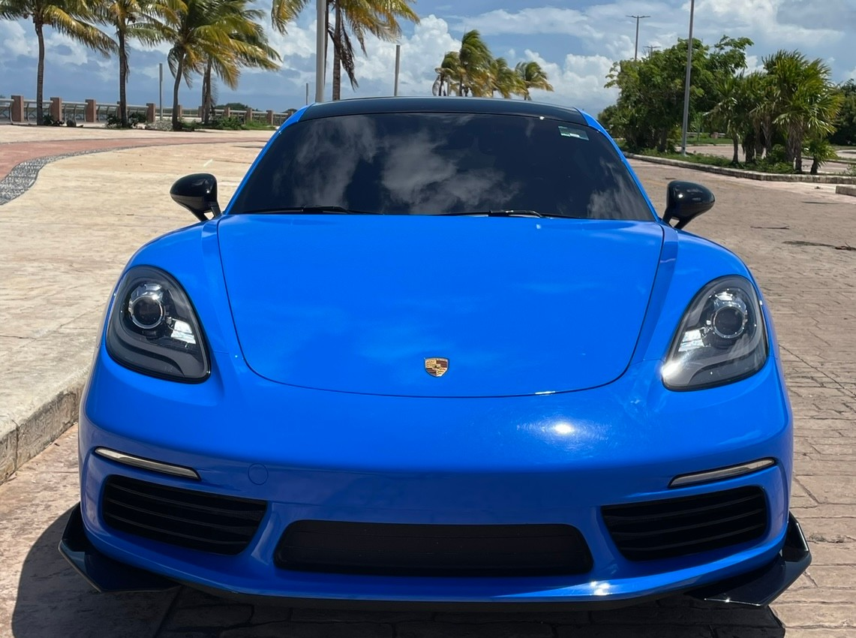
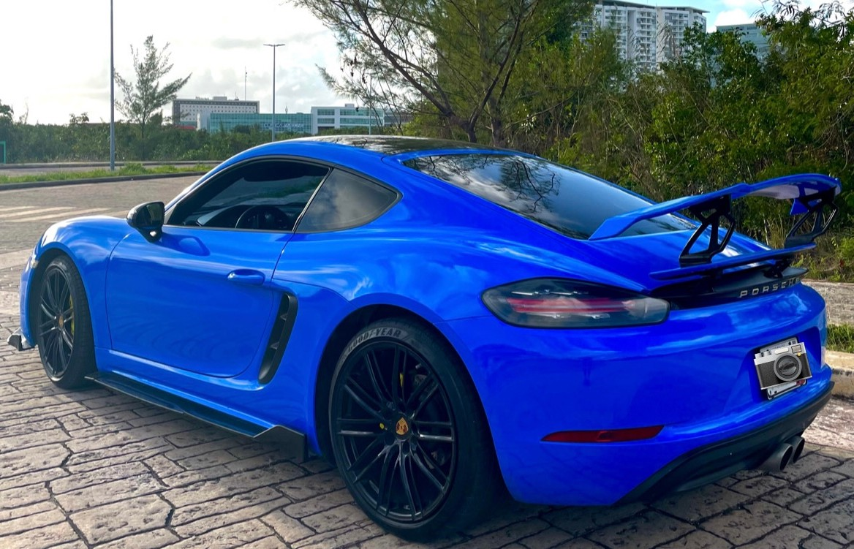
PORSCHE 718 CAYMAN S (2 PAX)
PRICE PER DAY
$1,300 USD
WARRANTY
$6,000 USD
CREDIT CARD OR CASH
@luxurycarsq.r

Slide 20
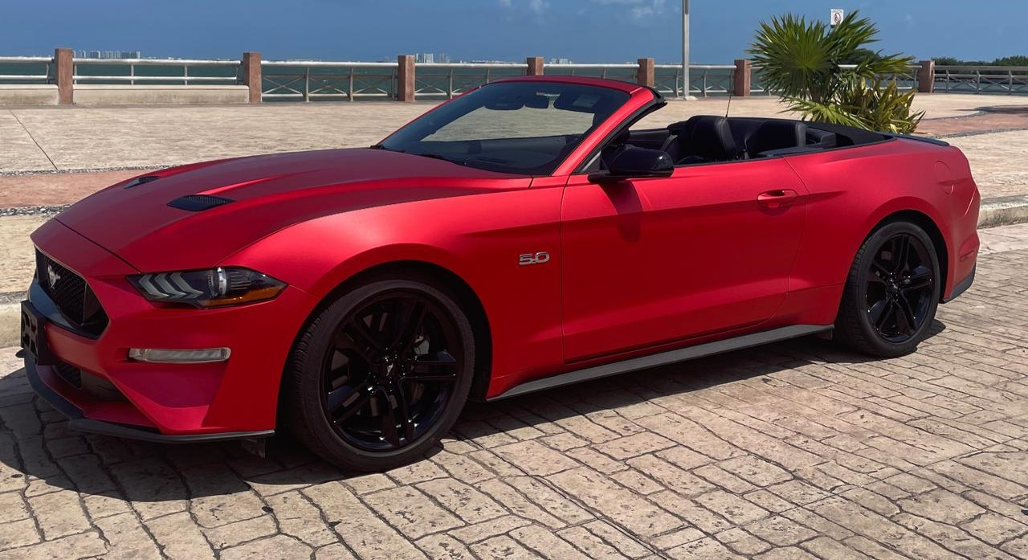
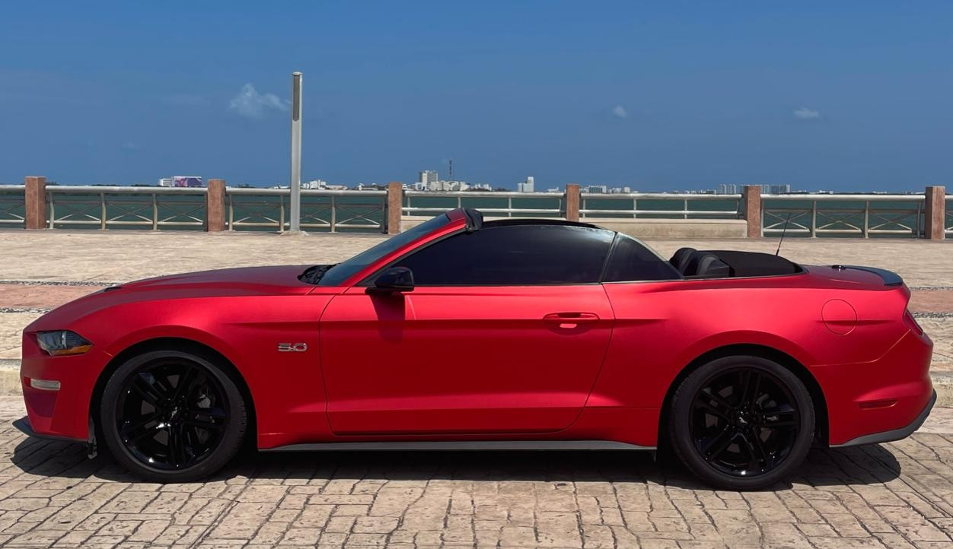
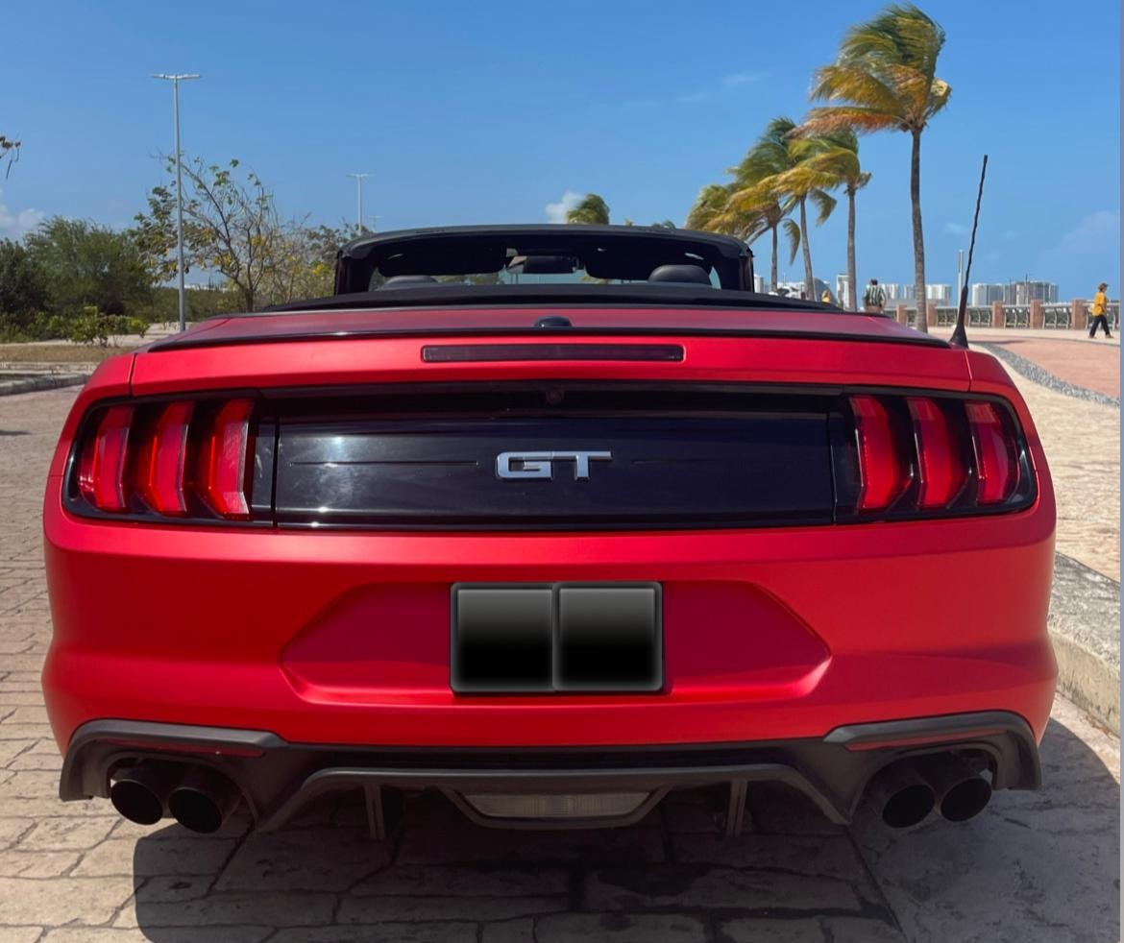
FORD MUSTANG GT 55 ANIVERSARIO (4 PAX)
PRICE PER DAY
$500 USD
WARRANTY
$2,500 USD
CREDIT CARD OR CASH

Slide 21
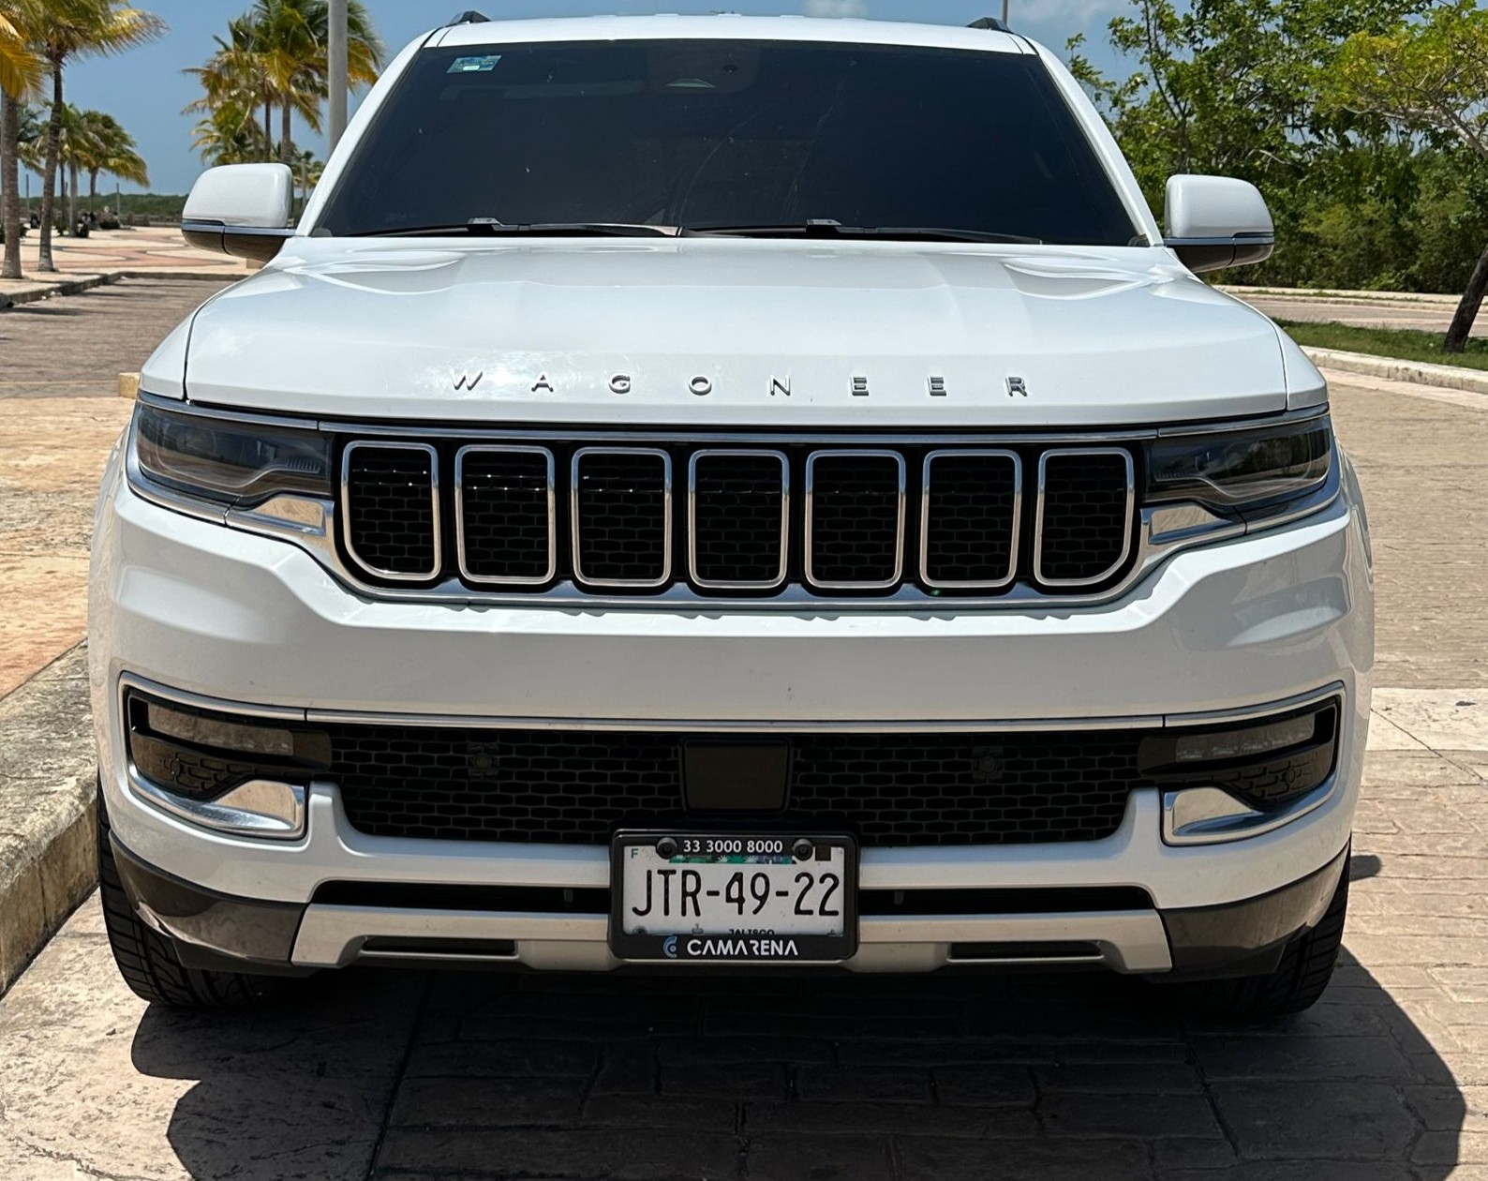
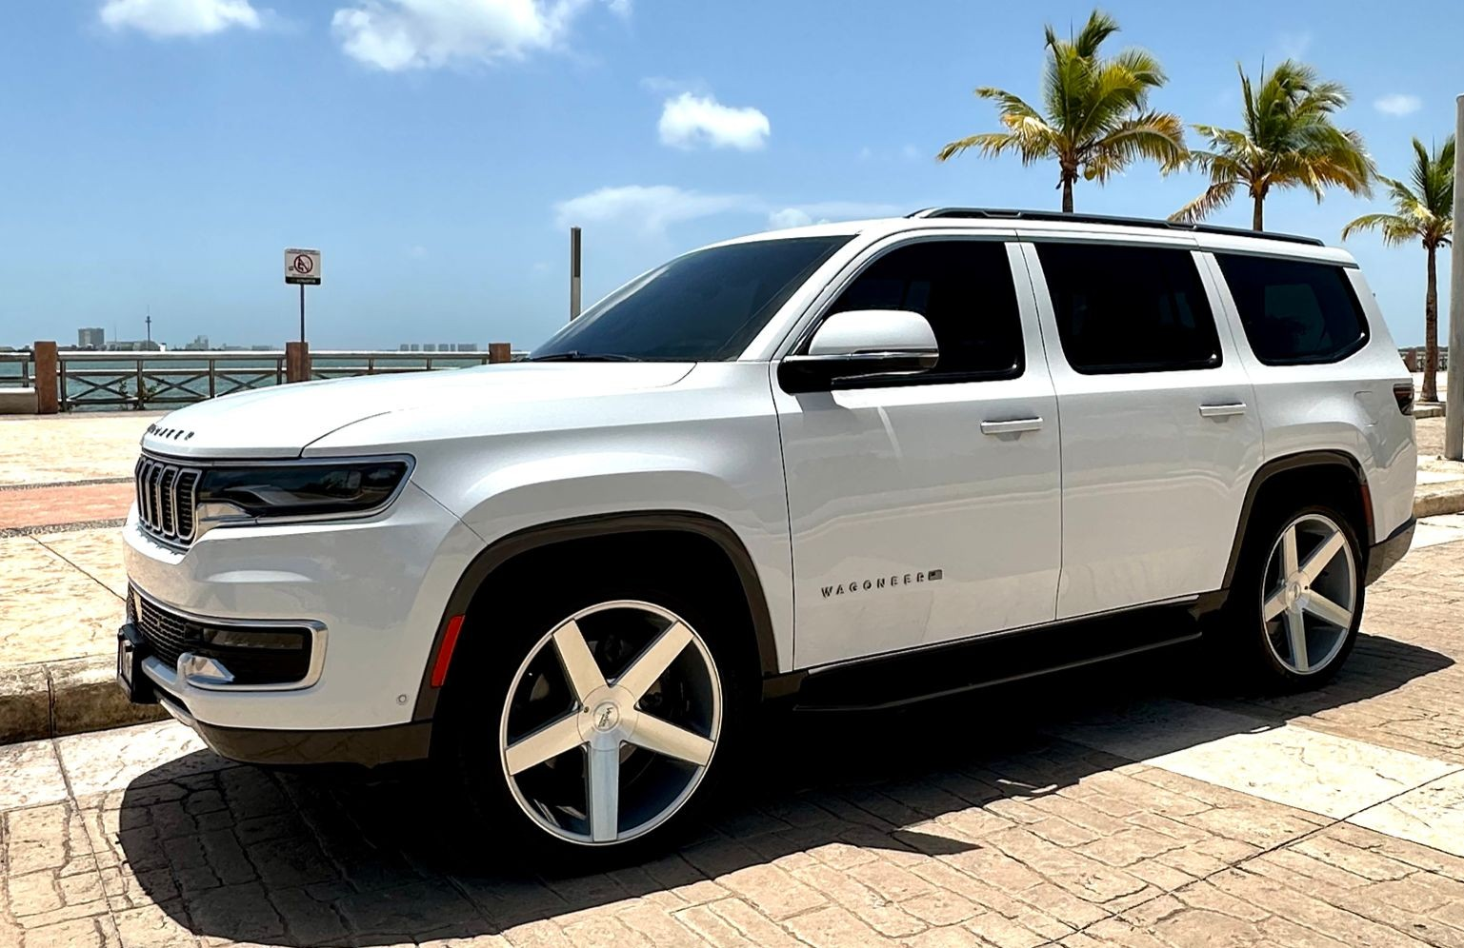
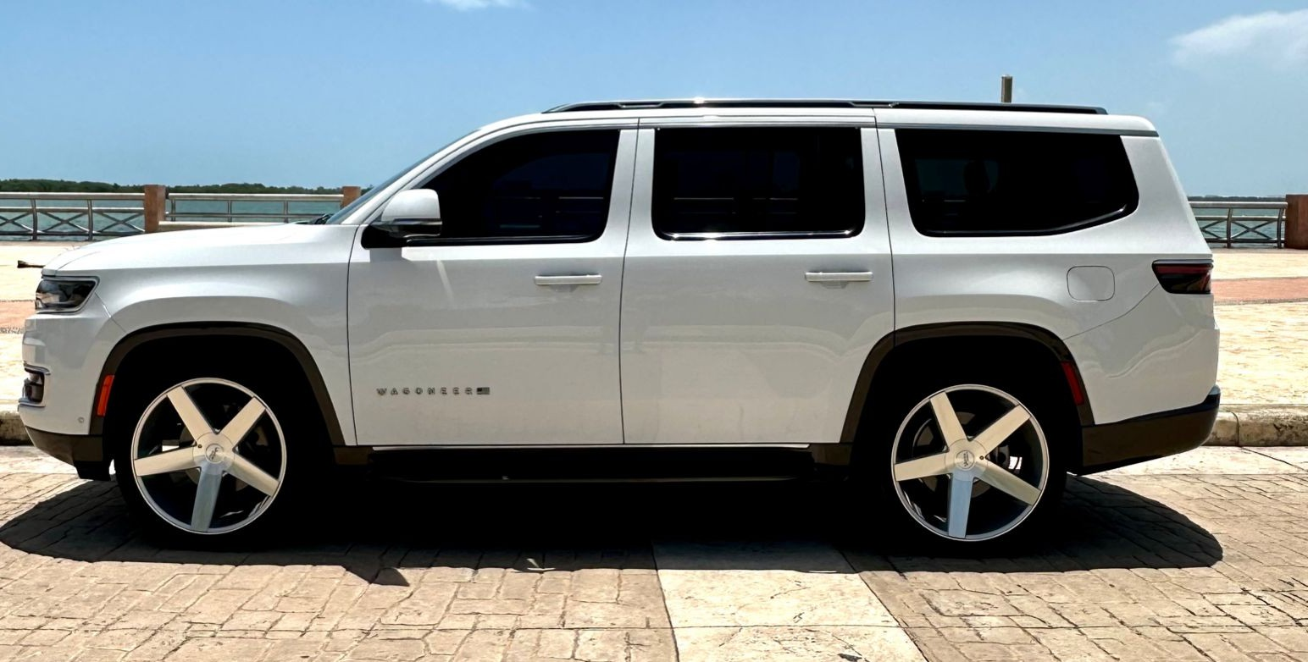
JEEP WAGONEER (7 PAX)
PRICE PER DAY
$750 USD
WARRANTY
$4,000 USD
CREDIT CARD OR CASH

Slide 22
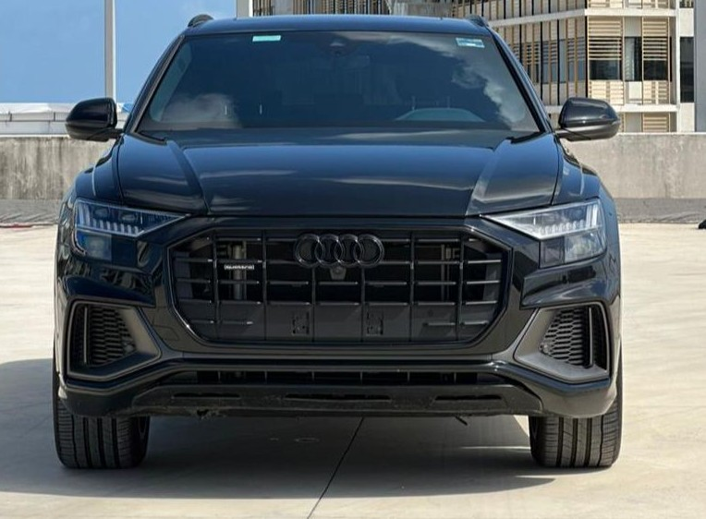
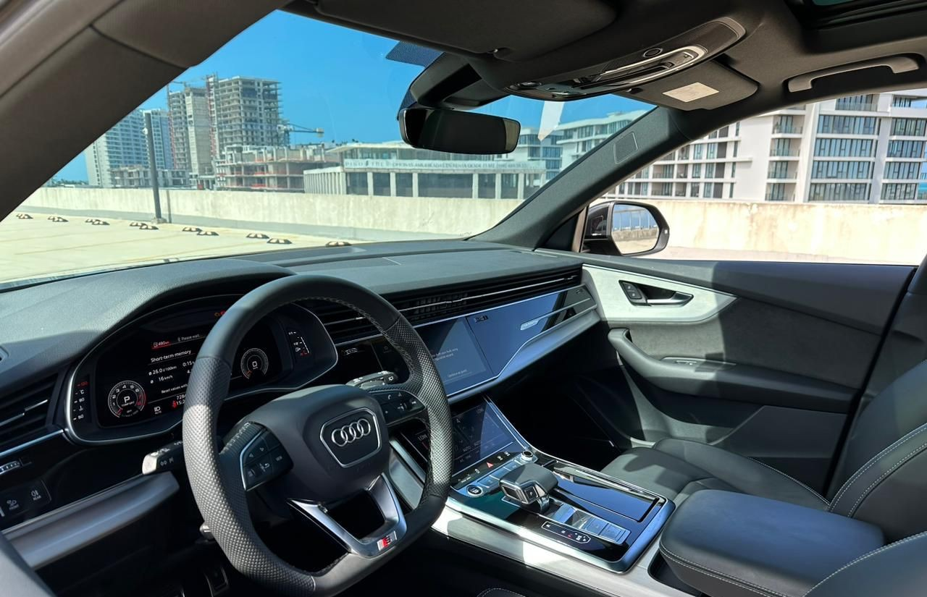
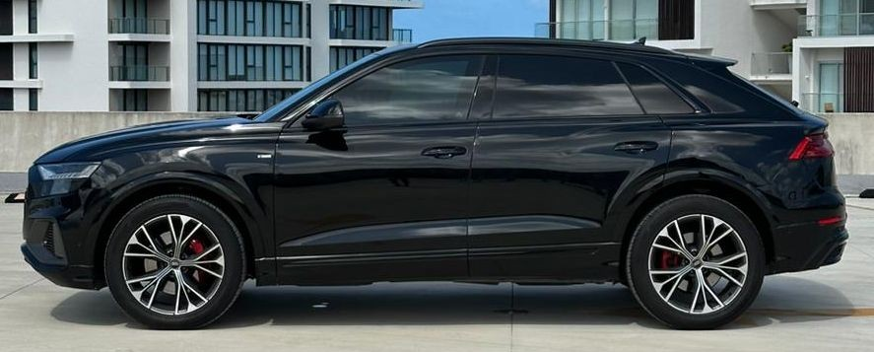
AUDI Q8 S-LINE (7 PAX)
PRICE PER DAY
$700 USD
WARRANTY
$3,000 USD
CREDIT CARD OR CASH

Slide 23



JAGUAR F-TYPE (2 PAX)
PRICE PER DAY
$1,350 USD
WARRANTY
$6,000 USD
CREDIT CARD OR CASH

Slide 24



BMW M240i (4 PAX)
PRICE PER DAY
$700 USD
WARRANTY
$2,500 USD
CREDIT CARD OR CASH

Slide 25


AUDI TT RS (4 PAX)
PRICE PER DAY
$600 USD
WARRANTY
$3,000 USD
CREDIT CARD OR CASH

Slide 26



GMC YUKON (7 PAX)
PRICE PER DAY
$450 USD
WARRANTY
$2,500 USD
CREDIT CARD OR CASH

Slide 27


BMW X6 M POWER (5 PAX)
PRICE PER DAY
$750 USD
WARRANTY
$3,500 USD
CREDIT CARD OR CASH

Slide 28



CHEVROLET TAHOE SRT ALL BLACK (7 PAX)
PRICE PER DAY
$600 USD
WARRANTY
$3,000 USD
CREDIT CARD OR CASH

Slide 29



LINCOLN NAVIGATOR (8 PAX)
PRICE PER DAY
$750 USD
WARRANTY
$4,000 USD
CREDIT CARD OR CASH

Slide 30


BMW I8 (4 PAX)
PRICE PER DAY
$1,450 USD
WARRANTY
$5,000 USD
CREDIT CARD OR CASH

Slide 31


BMW I8 (4 PAX)
PRICE PER DAY
$1,450 USD
WARRANTY
$5,000 USD
CREDIT CARD OR CASH

Slide 32


BMW M2 (4 PAX)
PRICE PER DAY
$600 USD
WARRANTY
$3,000 USD
CREDIT CARD OR CASH

Slide 33


BMW X5 (5 PAX)
PRICE PER DAY
$500 USD
WARRANTY
$2,000 USD
CREDIT CARD OR CASH

Slide 34


MERCEDES GLC (5 PAX)
PRICE PER DAY
$430 USD
WARRANTY
$2,000 USD
CREDIT CARD OR CASH

Slide 35



JEEP GRAND WAGONEER (8 PAX)
PRICE PER DAY
$750 USD
WARRANTY
$4,000 USD
CREDIT CARD OR CASH

Slide 36


CORVETTE 1977 (2 PAX)
PRICE PER DAY
$600 USD
WARRANTY
$2,000 USD
CREDIT CARD OR CASH

Slide 37


AUDI Q7 (7 PAX)
PRICE PER DAY
$450 USD
WARRANTY
$1,500 USD
CREDIT CARD OR CASH

Slide 38


GMC TERRAIN (5 PAX)
PRICE PER DAY
$350 USD
WARRANTY
$1,500 USD
CREDIT CARD OR CASH

Slide 39


FORD MUSTANG (4 PAX)
PRICE PER DAY
$350 USD
WARRANTY
$1,500 USD
CREDIT CARD OR CASH

Slide 40


CHEVROLET CAMARO (4 PAX)
PRICE PER DAY
$350 USD
WARRANTY
$1,500 USD
CREDIT CARD OR CASH

Slide 41


SUBURBAN LT (7 PAX)
PRICE PER DAY
$380 USD
WARRANTY
$1,500 USD
CREDIT CARD OR CASH

Slide 42


NISSAN ALTIMA (5 PAX)
PRICE PER DAY
$260 USD
WARRANTY
$800 USD
CREDIT CARD OR CASH

Slide 43


NISSAN SENTRA (5 PAX)
PRICE PER DAY
$200 USD
WARRANTY
$800 USD
CREDIT CARD OR CASH

Slide 44
MIAMI

Slide 45
REQUISITOS
REQUIREMENTS
PASAPORTE O INE
COMPROBANTE DE ESTADÍA
LICENCIA DE CONDUCIR VIGENTE
DEPOSITO EN GARANTÍA
*PASSPORT OR ID
* *PROOF OF ACCOMMODATION DRIVER’S LICENSE
*DRIVER’S LICENSE
*GUARANTEE DEPOSIT

Slide 46


PORSCHE 911 TURBO S
PRICE PER DAY
$1,000 USD
WARRANTY
$2,000 USD
CREDIT CARD OR CASH

Slide 47


PORSCHE MACAN M.BLUE
PRICE PER DAY
$600 USD
WARRANTY
$2,000 USD
CREDIT CARD OR CASH

Slide 48


MAYBACH
PRICE PER DAY
$1,350 USD
WARRANTY
$2,000 USD CREDIT CARD OR

Slide 49


MERCEDES BENZ S500
WARRANTY
$2,000 USD
CREDIT CARD OR CASH
PRICE PER DAY
$750 USD

Slide 50


LAMBORGHINI URUS
WARRANTY
$2,000 USD
PRICE PER DAY
$1,500 USD
CREDIT CARD OR CASH

Slide 51


ESCALADE SPORT
WARRANTY
$2,000 USD
CREDIT CARD OR CASH
PRICE PER DAY
$700 USD

Slide 52



Miami Blue McLaren 720 S
PRICE PER DAY
$1,650 USD
WARRANTY
$2,000 USD
CREDIT CARD OR CASH

Slide 53



Lamborghini Huracan Spyder Evo
PRICE PER DAY
$1,650 USD
WARRANTY
$2,000 USD
CREDIT CARD OR CASH

Slide 54



Mercedes Benz S580
PRICE PER DAY
$800 USD
WARRANTY
$2,000 USD
CREDIT CARD OR CASH
Lamborghini Huracan Spyder Evo

Slide 55



Range Rover Sport
PRICE PER DAY
$750 USD
WARRANTY
$2,000 USD
CREDIT CARD OR CASH

Slide 56



Miami Blue Corvette Z51
PRICE PER DAY
$1,150 USD
WARRANTY
$2,000 USD
CREDIT CARD OR CASH

Slide 57



Mercedes Benz E63s
PRICE PER DAY
$700 USD
WARRANTY
$2,000 USD
CREDIT CARD OR CASH

Slide 58



Bentley Bentayga V12 Blue
PRICE PER DAY
$1,350 USD
WARRANTY
$2,000 USD
CREDIT CARD OR CASH

Slide 59



Lamborghini Urus Arancio Borealis
PRICE PER DAY
$1,500 USD
WARRANTY
$2,000 USD
CREDIT CARD OR CASH

Slide 60



Lamborghini Urus Verde Mantis
PRICE PER DAY
$1,500 USD
WARRANTY
$2,000 USD
CREDIT CARD OR CASH

Slide 61



Bentley Bentayga V12 Black Re-Shoot
PRICE PER DAY
$1,350 USD
WARRANTY
$2,000 USD
CREDIT CARD OR CASH

Slide 62



Ferrari 488 GTB Red
PRICE PER DAY
$1,500 USD
WARRANTY
$2,000 USD
CREDIT CARD OR CASH

Slide 63



Mercedes Benz G550 4X4 Squared
PRICE PER DAY
$1,250 USD
WARRANTY
$2,000 USD
CREDIT CARD OR CASH

Slide 64



Lamborghini Urus Dark Grey
PRICE PER DAY
$1,500 USD
WARRANTY
$2,000 USD
CREDIT CARD OR CASH

Slide 65



Rolls Royce Culinan White Orange interior
PRICE PER DAY
$1,800 USD
WARRANTY
$2,000 USD
CREDIT CARD OR CASH

Slide 66



Lamborghini Urus White
PRICE PER DAY
$1,500 USD
WARRANTY
$2,000 USD
CREDIT CARD OR CASH

Slide 67



Lamborghini Urus Red
PRICE PER DAY
$1,500 USD
WARRANTY
$2,000 USD
CREDIT CARD OR CASH

Slide 68



Lamborghini Urus Red
PRICE PER DAY
$1,500 USD
WARRANTY
$2,000 USD
CREDIT CARD OR CASH

Slide 69



Ferrari 488 Spyder Rosso Corsa
PRICE PER DAY
$1,450 USD
WARRANTY
$2,000 USD
CREDIT CARD OR CASH

Slide 70



Lamborghini Urus Black/White Interior
PRICE PER DAY
$1,450 USD
WARRANTY
$2,000 USD
CREDIT CARD OR CASH

Slide 71



Lamborghini Huracan EVO Spyder
PRICE PER DAY
$1,450 USD
WARRANTY
$2,000 USD
CREDIT CARD OR CASH

Slide 72



Rolls Royce Cullinan
PRICE PER DAY
$2,200 USD
WARRANTY
$2,000 USD
CREDIT CARD OR CASH

Slide 73



Porsche Panamera Silver
PRICE PER DAY
$700 USD
WARRANTY
$2,000 USD
CREDIT CARD OR CASH

Slide 74



Rolls Royce Dawn Red
PRICE PER DAY
$1,550 USD
WARRANTY
$2,000 USD
CREDIT CARD OR CASH

Slide 75



Lamborghini Huracan LP610-4
PRICE PER DAY
$1,500 USD
WARRANTY
$2,000 USD
CREDIT CARD OR CASH

Slide 76



Rolls Royce Dawn
PRICE PER DAY
$1,450 USD
WARRANTY
$2,000 USD
CREDIT CARD OR CASH

Slide 77



McLaren 720s
PRICE PER DAY
$1,650 USD
WARRANTY
$2,000 USD
CREDIT CARD OR CASH

Slide 78



McLaren 650 s
PRICE PER DAY
$1,650 USD
WARRANTY
$2,000 USD
CREDIT CARD OR CASH

Slide 79



Lamborghini Huracan Black
PRICE PER DAY
$1,500 USD
WARRANTY
$2,000 USD
CREDIT CARD OR CASH

Slide 80



Ferrari 488 GTB
PRICE PER DAY
$1,450 USD
WARRANTY
$2,000 USD
CREDIT CARD OR CASH

Slide 81



Lamborghini Huracan Green
PRICE PER DAY
$1,550 USD
WARRANTY
$2,000 USD
CREDIT CARD OR CASH

Slide 82



Porsche Panamera
PRICE PER DAY
$700 USD
WARRANTY
$2,000 USD
CREDIT CARD OR CASH
¡

